Slide 1
Customer engagement: worldwide market shares 2019
John Abraham

Slide 2
About this report
This report provides market share data for communications service provider (CSP) spending on customer engagement software systems and related services for 2019. It provides details of how the spending varied by delivery model, service type, vendor and region. The report also includes profiles of the leading vendors in the market.
It is based on several sources, including:
  interviews with CSPs and vendors worldwide
  Analysys Mason’s research conducted during the past year.
GEOGRAPHICAL COVERAGE Worldwide Central and Eastern Europe Developed Asia–Pacific Emerging Asia–Pacific Latin America Middle East and North Africa North America Sub-Saharan Africa Western Europe | SUB-SEGMENT COVERAGE Engagement platforms Sales Marketing Customer service
What was the overall size of the market (customer engagement software systems for the telecoms industry) and what drove this spending among CSPs?
How did the spending vary across different sub-segments of the customer engagement market?
Who are the major vendors and what is their share of revenue in the customer engagement systems market?
What are the different drivers and growth rates of CSP spending on products, product-related services and professional services?
Vendor strategy teams that need to understand where growth is slowing and where it is increasing across different sub-segment categories.
Product management teams responsible for feature functionality and geographical focus, and product marketing teams responsible for market-share growth.
Market intelligence teams at vendors that want to understand how their competitors compare to each other.
CSPs that are planning digital transformation journeys and want to ensure that their current vendors are staying up to date.

Slide 3
Executive summary
Market shares
Overall telecoms market context
Vendor analysis
Market definition
About the author and Analysys Mason

Slide 4



Digital channels are increasingly replacing traditional channels as CSPs’ investments in the customer engagement segment become more product-centred
The customer engagement systems market grew by 0.3% worldwide in 2019, and this segment remains an area of strategic focus for CSPs. The market for customer engagement-related products grew by 5.4%, while that for professional services declined by 1.8%. This points to a shift from customised, services-heavy investments to spending on productised and standardised software systems. CSPs are continuing to dramatically reduce legacy customer engagement costs by increasing automation and using AI-based tools.
The digitisation of customer touchpoints was a priority in 2019 as CSPs continued to promote digital engagements over human interactions. There are three key benefits of digital engagements from a CSP perspective: better customer experience and loyalty, lower cost of operations and improved public perception.
The productisation of the engagement platform sub-segment continued in 2019; CSPs invested in building engagement frameworks that are cheaper to maintain and more-flexible in order to support future applications. CSPs’ investments in sales-related functions grew by 1.8%, but at a slower pace than in the past. Emerging enterprise opportunities remain a key driver for new spending.
CSP spending on customer service (the largest sub-segment by revenue) continues to decline, mainly because of reduced spending on expensive call centre functions. CSP spending on marketing functions grew by 1.9%, driven by the need to reduce the time to market for new offers.
Figure 1: Key pain-points that are driving CSPs to invest in digital engagement channels
Limited self-care capabilities
Most self-care functions are quite basic, not self-contained and incapable of driving deeper engagement with customers
High support costs
CSPs have large call-centre operations (outsourced or directly owned) that are expensive to run and impact margins
Complex architecture frameworks
Most incumbent systems are complex, disparate monoliths that slow down CSPs’ response to market changes
Source: Analysys Mason

Slide 5





5G has had limited impact on consumer telecoms systems, but remains an important influencer of CSP spending on enterprise experience functions
5G had a limited direct impact on CSP spending on customer engagement functions in 2019. This is because the initial wave of 5G applications and use cases are expected to be consumer-focused, and CSPs are already in the process of digitising their engagement channels and customer service functions.
However, 5G is influencing how CSPs are investing in customer engagement functions for new enterprise opportunities. This was an area of intense interest and discussion in 2019, but it only accounted for a small fraction of the overall spend in this segment. CSPs are investing to expand their capabilities around key functions in the enterprise customer engagement space.
Figure 2 shows the top five enterprise-related functions that CSPs are investing in. The following two factors will influence 5G-related CSP spending on digital engagement systems for enterprises.
  CSPs are learning how to efficiently deliver value to enterprises from digital companies and are adopting their best practices. As a result, they are evaluating applications even from non-telecoms vendors and are favouring a software-centred, digital-only, pay-as-you-grow approach to new deployments.
  CSPs need sales processes that are largely automated in order to effectively serve small and medium-sized enterprises. Only then can they take their offerings to a broader audience and compete against digital-native companies.
Figure 2: Key enterprise functions and capabilities that CSPs are investing in
CRM
To improve customer understanding, management and service
CPQ
To simplify ordering, accelerate time to market and lower the cost of sales
AI and automation
To drive deeper insights and improve process automation to reduce operating costs
Product catalogue
To effectively and swiftly support emerging 5G-enabled business models
Ecosystem enablers
To seamlessly support new partner services and multi-dimensional value chains
Source: Analysys Mason

Slide 6






SaaS has become the default delivery model for customer engagement functions
Software-as-a-service (SaaS) has become the default delivery model for the majority of new deployments in this segment. A key driver of this is the widespread adoption of SaaS-based digital engagement functions in other industries. The growing ubiquity of Salesforce’s solutions, especially among CSPs in developed markets, is another factor that has made SaaS commonplace.
SaaS is an important part of CSPs’ digital transformation initiatives. CSPs are increasingly willing to change process flows and organisation structures in order make better use of SaaS models. The lower cost of ownership and pre-defined annual payments help to build the support for SaaS among CSP finance teams; they have previously been hesitant about this delivery model because it shifts investments from capex to opex. The SaaS model will significantly reduce the overall CSP spending on customer engagement in the long term thanks to cuts in support, maintenance and other legacy system spending.
Customer engagement functions are not considered to be mission-critical (as is the case for monetisation functions), so it is more common for SaaS-based applications to be used to support core functions and business cases in this segment. Public cloud deployments remain the popular choice, but some SaaS deployments continue to use vendor-owned private infrastructure.
The growing adoption of SaaS is leading to increased competition among traditional telecoms vendors because CSPs are increasingly considering vendors with an enterprise focus.
Figure 3: Key benefits of SaaS delivery models
Shorter time to market
Flexible
configurability
Lower cost of
ownership
Key benefits
of SaaS
delivery models
Automatic upgrades
Centralised
management
Simplified homogenous
architecture
Dynamically scalable
Source: Analysys Mason

Slide 7
Key recommendations
1
Software vendors should increase their visibility as end-to-end support providers for CSPs’ mobile-first and digital-only customer engagement strategies.
CSPs are experimenting with and adopting a number of changes to their digital engagement channels. These include redesigning their mobile apps, introducing virtual assistants and trialling VR applications. The lack of end-to-end support from telecoms-focused vendors when adopting leading-edge customer engagement functions is forcing CSPs to look to other verticals for inspiration and support.
2
Vendors should provide the option to use a SaaS delivery model for their customer engagement solutions.
SaaS has become the default delivery model for customer experience functions. Indeed, SaaS is likely to become an essential pre-requisite for new deployments in this segment in the medium term.
3
Vendors should prioritise and call attention to their enterprise experience strategies.
CSPs are expected to make considerable investments in enterprise experience functions in the short-to-medium term. These systems are expected to become an essential ingredient in CSPs’ future operating frameworks. Telecoms vendors should partner with providers of enterprise functions or invest in developing appropriate expertise and solutions to pursue the enterprise customer engagement market.

Slide 8
Executive summary
Market shares
Overall telecoms market context
Vendor analysis
Market definition
About the author and Analysys Mason

Slide 9
Customer engagement revenue market share
Figure 4: Customer engagement total revenue by type, worldwide, 2019
Figure 5: Customer engagement total revenue by vendor, worldwide, 2019¹
PRODUCT
Total 2019:
USD14.3 billion
Year-on-year growth:
0.3%
PROFESSIONAL SERVICES
Source: Analysys Mason
¹ Other vendors include Atento, Huawei, Netcracker, Nokia and Teleperformance. We have revised the 2018 customer engagement revenue for Atento and Nokia based on new information and guidance provided.

Slide 10
Customer engagement revenue market share
Figure 6: Customer engagement product revenue by vendor, worldwide, 2019¹
Figure 7: Customer engagement professional services revenue by vendor, worldwide, 2019¹
Total 2019:
USD4.96 billion
Year-on-year growth:
2.2%
Total 2019:
USD9.35 billion
Year-on-year growth:
–0.8%
Source: Analysys Mason
Source: Analysys Mason
¹ Other vendors include Avaya, Capgemini, CGI Group, Microsoft, Pegasystems, SAP and Tech Mahindra.

Slide 11
Engagement platforms product revenue market share
Figure 8: Engagement platforms product revenue by vendor, worldwide, 2019¹
Figure 9: Product revenue and growth of top-six vendors compared to overall product revenue growth in the engagement platforms market, 2019
Total 2019:
USD1.09 billion
Year-on-year growth:
2.1%
Source: Analysys Mason
¹ Other vendors include Avaya, Genesys, Microsoft, Pegasystems and SAP.

Slide 12
Engagement platforms professional services revenue market share
Figure 10: Engagement platforms professional services revenue by vendor, worldwide, 2019¹
Figure 11: Professional services revenue and growth of top-six vendors compared to overall professional services revenue growth in the engagement platforms market, 2019
Total 2019:
USD2.04 billion
Year-on-year growth:
–0.1%
Source: Analysys Mason
¹ Other vendors include Capgemini, IBM, Nokia, Sykes, Tech Mahindra and Teleperformance.

Slide 13
Sales product revenue market share
Figure 12: Sales product revenue by vendor, worldwide, 2019¹
Figure 13: Product revenue and growth of top-six vendors compared to overall product revenue growth in the sales market, 2019
Total 2019:
USD1.55 billion
Year-on-year growth:
3.9%
Source: Analysys Mason
¹ Other vendors include Hansen Technologies, IBM, Microsoft, Pegasystems and Tieto.

Slide 14
Sales professional services revenue market share
Figure 14: Sales professional services revenue by vendor, worldwide, 2019¹
Figure 15: Professional services revenue and growth of top-six vendors compared to overall professional services revenue growth in the sales market, 2019
Total 2019:
USD2.29 billion
Year-on-year growth:
0.3%
Source: Analysys Mason
¹ Other vendors include Capgemini, Huawei, Netcracker, Tech Mahindra and Tieto.

Slide 15
Marketing product revenue market share
Figure 16: Marketing product revenue by vendor, worldwide, 2019¹
Figure 17: Product revenue and growth of top-six vendors compared to overall product revenue growth in the marketing market, 2019
Total 2019:
USD767 million
Year-on-year growth:
1.9%
Source: Analysys Mason
¹ Other vendors include Asiainfo, Comarch, IBM, Nokia and Pegasystems.

Slide 16
Marketing professional services revenue market share
16
Figure 18: Marketing professional services revenue by vendor, worldwide, 2019¹
Figure 19: Professional services revenue and growth of top-six vendors compared to overall professional services revenue growth in the marketing market, 2019
Total 2019:
USD858 million
Year-on-year growth:
1.3%
Source: Analysys Mason
¹ Other vendors include Amdocs, Capgemini, SAP, Tata Consultancy Services and Tech Mahindra.

Slide 17
Customer service product revenue market share
Figure 20: Customer service product revenue by vendor, worldwide, 2019¹
Figure 21: Product revenue and growth of top-six vendors compared to overall product revenue growth in the customer service market, 2019
Total 2019:
USD1.56 billion
Year-on-year growth:
0.8%
Source: Analysys Mason
¹ Other vendors include Avaya, CSG International, Genesys, SAP and Sicap.

Slide 18
Customer service professional services revenue market share
18
Figure 22: Customer service professional services revenue by vendor, worldwide, 2019¹
Figure 23: Professional services revenue and growth of top-six vendors compared to overall professional services revenue growth in the customer service market, 2019
Total 2019:
USD4.16 billion
Year-on-year growth:
–2.0%
Source: Analysys Mason
¹ Other vendors include Accenture, Amdocs, Capgemini CGI Group, Nokia and Tech Mahindra.

Slide 19
Executive summary
Market shares
Overall telecoms market context
Vendor analysis
Market definition
About the author and Analysys Mason

Slide 20
Overall telecoms services: revenue split and trends for regional markets
Figure 24: Share of worldwide USD1.578 trillion telecoms service revenue and trends by region, 2019
NORTH AMERICA
32%
Fixed and mobile data service revenue growth will drive the total telecoms revenue growth.
5G take-up is expected to grow rapidly as 5G coverage improves and spectrum becomes available.
WESTERN EUROPE
19%
Fixed broadband household penetration will continue to grow in all countries.
The adoption of 5G will have a small impact on mobile revenue.
CENTRAL AND EASTERN EUROPE
5%
Mobile handset data and fixed broadband are the largest areas for revenue growth.
Operators will continue to invest in improving LTE network coverage and speeds.
DEVELOPED ASIA–PACIFIC
12%
Revenue growth will be driven by demand for gigabit access speeds.
The growing demand for 5G services and their rapid take-up will limit mobile ARPU decline.
LATIN AMERICA
6%
Growth in fixed broadband, mobile handset and pay-TV revenue will drive overall growth.
Investments in mobile and fixed infrastructure will increase.
5G will be launched in 2021.
SUB-SAHARAN AFRICA
2%
Mobile services will continue to generate the vast majority of telecoms revenue.
Rapid handset data revenue growth drive the overall telecoms revenue growth.
MIDDLE EAST AND NORTH AFRICA
4%
Fixed broadband revenue growth will offset the decline in traditional voice services revenue.
Spending on improving mobile data speeds and coverage will increase.
EMERGING ASIA–PACIFIC
20%
Pay-TV revenue will grow sharply, driven by improved internet coverage and speeds.
The mobile penetration rate is expected to grow strongly in countries with low starting bases.
Source: Analysys Mason

Slide 21
Overall telecoms services: regional service breakouts
Figure 25: Metrics for the eight regions modelled individually and worldwide, 2019
 | Population (million)¹ | GDP (USD billion)¹ | GDP per capita (USD thousand)¹ | Telecoms revenue |  |  |  | Mobile SIM population penetration² | Fixed broadband population penetration³
 |  |  |  | Mobile (USD billion) | IoT (USD billion) | Consumer fixed (USD billion) | Business fixed (USD billion)
North America | 367.6 | 23 172 | 63.0 | 202.3 | 3.4 | 192.8 | 102.6 | 106.2% | 34.6%
Latin America | 651.1 | 5 285 | 8.1 | 48.6 | 0.6 | 32.8 | 14.5 | 101.9% | 13.4%
Western Europe | 422.5 | 17 714 | 41.9 | 114.8 | 2.2 | 99.8 | 76.9 | 122.6% | 39.1%
Central and Eastern Europe | 407.9 | 4 473 | 11.0 | 39.4 | 0.9 | 16.6 | 14.8 | 132.9% | 22.3%
Developed Asia–Pacific | 247.0 | 9 775 | 39.6 | 102.4 | 1.3 | 48.6 | 42.3 | 130.7% | 34.9%
Emerging Asia–Pacific | 4072.7 | 20 773 | 5.1 | 218.6 | 5.4 | 64.1 | 28.5 | 96.4% | 12.6%
Middle East and North Africa | 459.5 | 3 639 | 7.9 | 42.6 | 0.4 | 12.4 | 9.6 | 107.8% | 7.5%
Sub-Saharan Africa | 1123.7 | 1 726 | 1.5 | 32.1 | 0.3 | 4.0 | 2.7 | 76.9% | 0.5%
Worldwide | 7751.9 | 86 556 | 11.2 | 800.9 | 14.5 | 471.2 | 291.8 | 99.6% | 14.3%
  Macroeconomic and general regional factors (such as population) provide significant context for the telecoms revenue figures that we track in the Analysys Mason DataHub. The availability of fixed broadband services remains limited in Latin America, emerging Asia–Pacific, the Middle East and North Africa and Sub-Saharan Africa because of the costs associated with infrastructure deployment and the low GDP per capita, both of which limit service affordability. Mobile SIM penetration in Sub-Saharan Africa is growing steadily, but remains considerably lower than 100% (it is close to, or above, 100% elsewhere). Almost 50 operators worldwide launched 5G services in 2019, and many more are preparing to do the same in 2020. Many 5G launches are associated with improved network capacity and data speeds, and several CSPs initially offered 5G in the form of fixed-wireless access broadband. CSPs in North America and developed Asia–Pacific are leading the 5G race, but those in emerging regions such as China are also moving quickly.
¹ Population and GDP data is from the Economist Intelligence Unit. The rest of the data are from Analysys Mason’s DataHub.
² Excludes IoT SIMs.
³ Total fixed broadband connections (including business) expressed as a share of population.

Slide 22
Overall telecoms services: regional service comparison
Figure 26: Overall telecoms revenue by region and service type, 2019
Source: Analysys Mason

Slide 23
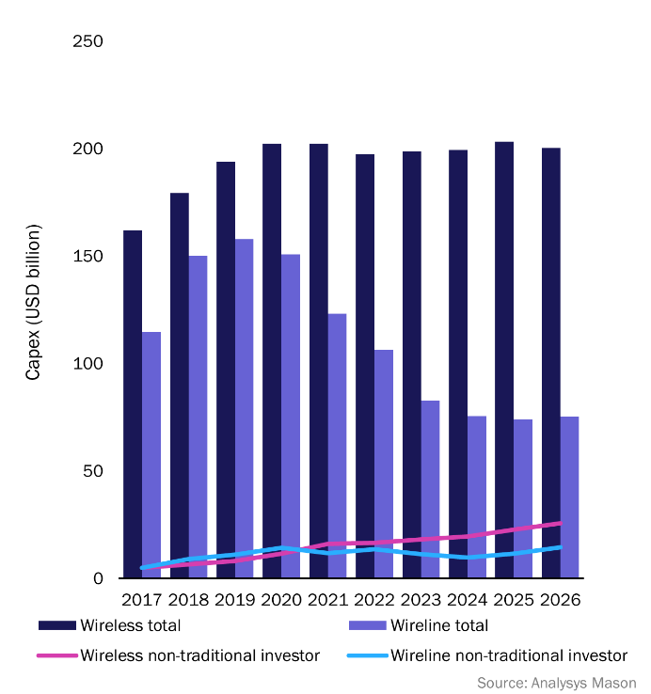
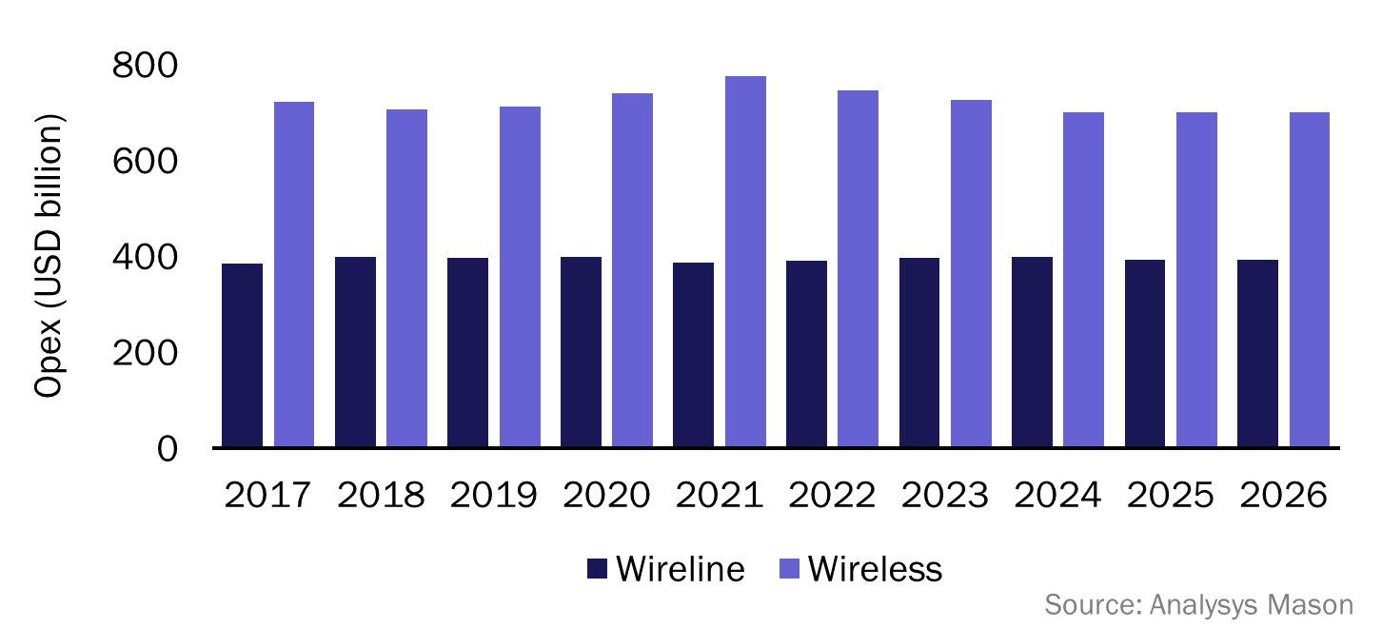
Overall telecoms services: investments and spending
Figure 27: Wireline and wireless capex (including that from non-traditional investors), worldwide, 2017–2026
Figure 28: Wireline and wireless opex, worldwide, 2017–2026
CSP spending on telecoms software is heavily influenced by both overall investment levels (capex) and overall expenses (opex).
Network capex was approximately USD350 billion in 2019, and telecoms software accounted for approximately USD52 billion of this (15%). CSPs are under increasing pressure to reduce opex and protect margins as revenue growth slows. This will lead to an increase in telecoms software spending in order to reduce operational costs through automation. Telecoms software capex as a percentage of the total software spend is falling because software technology is increasingly being delivered as a service.
Telecoms software opex was approximately USD25 billion in 2019 (2% of the total network opex).

Slide 24
Overall telecoms services: key industry drivers
Figure 29: key drivers of the telecoms software and services industry
Driver | Key elements | Discussion
5G | Converged core Cloud RAN Infrastructure investments Network slicing Optimising capex/opex | Investment in 5G is the biggest single factor driving the telecoms software and services industry. Such investments drive software spending for the network itself, for network orchestration and automation and for improvements to OSS and BSS.
Cloud | Moving current payloads to public cloud Cloud-native development Cloud technology for telecoms networks Platform data services/AI Edge computing | Cloud is disrupting the way in which all industries work, including telecoms. The biggest near-term issue is moving existing payloads to the cloud. However, there is a greater emphasis on using software offered as a service, generally in the public cloud and for new cloud-native development, including of the network itself.
Enterprise services | SD-WAN IoT ecosystems Cloud IT services Enterprise digital experience/self service Private 5G | CSPs are placing a greater emphasis on making money from enterprise services. There are a range of drivers including cloud IT services and IoT. SD-WAN provides lower costs and faster deployments, thereby enabling new use cases. Enterprises now expect self-service through a digital experience.
Digital transformation | Digital experience Automated customer journeys Cloud-loop automation/lower TCO Use of cloud services/SaaS Culture change (to be like cloud providers) | The telecoms industry has been pushing digital transformation for some time and is now getting significant pay-off. Nearly all CSPs have deployed and are improving digital customer channels. Increased levels of automation lower network operational costs. All this has been made possible by underlying changes to enable the use of cloud methods and more cloud services.
Network disaggregation | Impact of virtual networks Infrastructure capex changes Infrastructure as real estate Cell densification Private 5G | Digital transformation has led to network disaggregation. The full vertical integration of networks and services is no longer necessary nor always efficient. Investors such as towercos, fibrecos and hosting centres provide wholesale access to fundamental infrastructure used by many retail service providers.

Slide 25
Executive summary
Market shares
Overall telecoms market context
Vendor analysis
Market definition
About the author and Analysys Mason

Slide 26

Accenture
CUSTOMER ENGAGEMENT
www.accenture.com
1989
Accenture is a global professional services firm that offers consulting and operational services to multiple sectors, including banking, retail and telecoms.
Accenture offers a range of services to the telecoms sector, including strategy and business consulting, outsourced operations and systems integration services.
Its digital customer interaction services help CSPs to personalise customer interactions across all channels using analytics and content management capabilities.
It is supporting CSP clients in digital transformation projects for business support systems in order to deliver user-level engagement in an omni-channel environment.
Accenture is highly regarded for its technology transformation, organisation change and digital experience expertise.
The company has a well-entrenched presence in digital transformation projects at multiple Tier-1 CSPs.
It has partnerships with leading customer engagement product vendors including Nokia, Oracle, Salesforce and SAP.
However, many product vendors are beginning to offer services on their own – this may limit Accenture’s ability to use vendor partnerships to access CSPs. In addition, SaaS deployments, which require limited professional services support, are increasing.
Nokia
Oracle
SAP
Dublin (HQ)
Worldwide
It will enhance its services offerings to support CSPs’ initiatives to become digital service providers.
The company will continue to expand and build relationships with established and upcoming software vendors.

Slide 27
Amdocs
CUSTOMER ENGAGEMENT
www.amdocs.com
1982
Amdocs is a leading software products and services company that specialises in BSS for the telecoms, media and entertainment industries.
Amdocs DigitalONE is a cloud-native platform that provides commerce and care functions across any channel. The platform is open, modular and built microservices. DigitalONE is part of the CES20 full BSS/OSS suite.
Amdocs CatalogONE is a cloud-native catalogue solution for BSS and OSS.
Amdocs Optima is a digital BSS suite covering care, commerce, billing and charging that is targeted at Tier-2/3 CSPs and MVNOs.
Amdocs provides professional services, mainly business consulting and managed services capabilities.
Amdocs also offers MS360 as a microservices foundation to enable CSPs to own or co-develop DevOps applications.
Amdocs is well-entrenched with many large CSPs and is one of the leading vendors with an end-to-end BSS offering. It can be deployed as best of breed thanks to its modular framework.
The company has a growing vendor-agnostic professional services base, which may be attractive to CSPs preparing for digital transformation.
The company has improved its reach among Tier-3/4 CSPs and MVNOs with Amdocs Optima.
Amdocs has also been growing inorganically in this segment and in the media vertical, with key acquisitions of companies such as Vubiquity, Vindicia, UXPsystems, projeckt202, Brite:bill and Pontis.
IBM
Adobe
AWS
Chesterfield, MO (HQ)
Amdocs’s inorganic growth through acquisitions will provide it with expanded coverage in telecoms and media verticals worldwide.
It will continue to enhance its product and services offerings to support telecoms and media digital transformation initiatives.
Amdocs is establishing a partner ecosystem that offers complementary capabilities. It will aim to use this network for new sales.

Slide 28
Ericsson
CUSTOMER ENGAGEMENT
www.ericsson.com
1876
Ericsson is a major equipment, software and services company that serves multiple industry verticals, including telecoms.
Ericsson’s device management product suite includes Enterprise Mobility Management, Automatic Device Configuration and Remote Device Manager.
Device Connection Platform is cloud-based and focused on the M2M sector.
It has a strong professional services portfolio in the telecoms sector, including supporting CSPs with systems integration and managed services.
It added product catalogue and order orchestration products to its portfolio through the acquisition of ConceptWave.
In January 2019, Ericsson restructured its digital BSS business at a cost of around USD687 million. The company has since announced a strategic shift in its digital BSS portfolio, with a greater focus on a phased approach to digital transformation.
Ericsson continues to have a strong brand, worldwide channel coverage and well-regarded managed services expertise. The company is well-positioned in large end-to-end transformations that include network components.
Ericsson’s customer engagement capability is heavily partner-reliant. The company is working towards building some key functions in-house.
IBM
TCS
Stockholm (HQ)
Ericsson will continue to focus on growth in emerging markets and also large transformation projects.
It will enhance its device management product capability and expand its coverage for customer engagement.
The company will continue to partner with vendors to enhance its customer engagement systems portfolio.

Slide 29
Flytxt
CUSTOMER ENGAGEMENT
www.flytxt.com
2008
Flytxt is an independent supplier of customer data analytics and intelligent marketing automation software in the telecoms sector.
The NEON-dX platform has four main applications: Precision Marketer for multi-channel campaign management and real-time contextual marketing, Intent Management for personalisation and next-best offers, Insight Workbench for collaborative data analytics and Precision Ad Server for targeted mobile advertising.
It also has multiple add-ons such as Digital-Plus for extending customer engagement over digital channels such as social media, Packaged Analytics Models for augmenting marketing decision making, Robo-X for autonomous marketing and Talk-2-Me for enabling human-like conversations over voice interfaces such as Amazon Alexa or Google Assistant.
Flytxt counts multiple Tier-1 CSPs in emerging markets as customers.
Flytxt’s ambitions to further penetrate into developed markets have yet to gather traction.
Operators are increasingly interested in analytics and AI-driven solutions, and Flytxt is well-placed to take advantage of this interest.
Flytxt is increasingly investing in its engagement-focused capabilities, bringing in both products and associated services to the market. Its new positioning will help operators to solve specific business use cases.
Atos
VoltDB
Wipro
Amsterdam (HQ)
It has presence in Asia, Latin America, Africa and the Middle East. It aims to expand to other regions, including Europe and North America.
It will enhance its products with add-ons to accelerate the adoption and use of artificial intelligence and machine learning technologies.
The company aims to continue to grow organically as well as increase its focus on partnerships to expand its market reach.

Slide 30
Genesys
CUSTOMER ENGAGEMENT
www.genesys.com
1990
Genesys is a provider of omni-channel customer experience and contact centre solutions to medium-sized and large businesses.
The Genesys interactive voice response (IVR) system is widely deployed by CSPs to provide customer self-care support.
The solution includes contact centre software, a voice platform, conversation management, intelligent routing and advanced reporting.
Genesys also provides contact centre software, digital sales systems, workforce management solutions and automation support through voice and chat bots.
Genesys is one of the largest providers of customer support services supporting over 11000 customers across multiple industries.
The Genesys offerings provide an overall customer contact centre platform for a wide variety of industries.
Genesys, similar to other vendors that have traditionally offered CTI-related software systems, is facing a challenging market environment as cloud-based systems mature.
However, it is pivoting its strategy towards a cloud-based engagement function-driven offerings model.
Accenture
IBM
Daly City, CA (HQ)
It will continue to target WE, CEE and North America.
It will enhance its product offerings to support CSPs’ objective of enabling digital user engagement.
It will continue with its current sales approach.

Slide 31
Huawei Technologies
CUSTOMER ENGAGEMENT
www.huawei.com
1987
Huawei provides network infrastructure, software solutions and professional services to the telecoms and enterprise sectors.
Huawei’s BES portfolio includes cloud-based offerings for the customer engagement segment. It currently offers the following services.
Dealer Agent Cloud helps CSPs to expand their dealer networks by reducing the registration time by an order of magnitude, as well as simplifying the customer registration process.
Huawei has a strong professional services offering that includes systems integration, outsourced operations and software product-associated managed services.
Huawei’s customer engagement revenue growth has slowed down, partly due to geopolitical factors and also due to the company increasing its focus on existing customers.
Huawei’s portfolio in the customer engagement segment has a stronger presence in emerging markets where it is a low-cost provider.
Its managed services and systems integration expertise, together with its product portfolio, enables it to deliver highly customised solutions to the market.
Accenture
SAP
Infosys
Shenzhen (HQ)
Worldwide focus with the exception of some developed countries. Huawei will limit new customer engagement deals to some regions.
Huawei will increase focus on its B2B portfolio and favour a cloud-hosted SaaS-based business model.
Huawei is expanding its channel coverage by partnering with professional services companies.

Slide 32
IBM
CUSTOMER ENGAGEMENT
www.ibm.com
1911
IBM is a global technology firm that offers business consulting services including customer experience, operational efficiency and network optimisation to the telecoms sector.
IBM Customer Experience Suite offers a wide variety of services for customer interactions including:
    cloud and mobile solutions
    omni-channel experience
    intelligent campaigns and customer value optimisation.
IBM has multiple solutions based on its cognitive system, WATSON. For customer engagement, this includes the following functions.
    Assist agents to engage with customers and support multiple use cases, including CLV, churn and segmentation.
    Virtual agent to deliver personalised engagement and reduces costs.
The company is the go-to-market vendor for business process optimisation. In addition, it also has strong offerings in proactive care, behaviour-based customer insight, customer experience analytics and network analytics.
Digital customer engagement is one of three strategic focus pillars for IBM. However, this is the smallest segment in terms of revenue contributions.
It is a strong e-commerce player in the enterprise market and is using this experience to target the telecoms sector.
The company is well-positioned for opportunities around machine learning and artificial intelligence functions, which is attracting increasing investments from CSPs.
Oracle
SAP
Wipro
North Castle, NY (HQ)
It has a global footprint, and will continue to focus on delivering to its customers.
It will use its analytics and business process optimisation expertise to serve telecoms software segments.
It will continue to use its relationships and expertise in other sectors to expand in the telecoms market.

Slide 33
Microsoft
CUSTOMER ENGAGEMENT
www.microsoft.com
1975
The Microsoft Dynamics 365 suite offers customer engagement solutions to enterprises and the telecoms industry.
Microsoft Dynamics 365 is the company’s CRM and ERP solution portfolio targeted at enterprises. Its customers includes big and small companies across multiple verticals including CSPs.
Microsoft Dynamics 365 includes support multiple applications covering sales, customer service, marketing, commerce, operations, field service etc.
The customisation of the company’s CRM software for a telecoms-specific audience is ongoing, but is dependent upon Microsoft’s ecosystem.
Microsoft Dynamics CRM has a large existing CSP customer base, although many of these customers have CRM systems from other vendors as well.
Microsoft’s is seeing increasing traction for the adoption of its CRM suite, although it continue to trail the primary competitors in the telco market by reasonable margins.
For the telecoms sector, Microsoft’s objective of building an ecosystem around its Dynamics CRM 365 offerings has not reached its expected potential.
Hitachi
SunVizion
Redmond, WA (HQ)
Worldwide, with a specific focus on developed markets.
The company will aim to enhance its current product suite to meet the demands of CSP clients.
Microsoft will endeavour to expand its new partnership programme with other leading ISVs.

Slide 34
Netcracker
CUSTOMER ENGAGEMENT
www.netcracker.com
1993
Netcracker provides software solutions to the telecoms sector, including revenue and customer management solutions.
The Netcracker 2020 portfolio is a full-stack modular communications infrastructure solution that supports OSS and BSS functions. The platform is 5G ready and cloud-native compliant.
Netcracker 2020 covers two BSS product segments:
  Customer Engagement which includes channel, customer journey and marketing management
  Digital BSS which includes customer, revenue and partner management.
Netcracker also has platform management and analytics capabilities available across their portfolio.
The company also provides well-established professional services for its offerings.
Netcracker 2020 platform emphasises mobile-first digital experience with a contextually aware omni-channel solution.
It also provides enhanced support for partner-driven business models and access to a partner ecosystem.
The majority of Netcracker’s customer engagement deals are as part of a full stack BSS transformation where the company is highly competitive.
The company has extensive managed services expertise and a good delivery record for large-scale transformations across CSPs of all tiers.
Accenture
Atos
HPE
Waltham, MA (HQ)
The company continues to strengthen its position in markets outside Japan and North America.
The company will continue to build a more holistic OSS and BSS offering to support CSPs’ digitalisation objectives.
It will continue with its direct sales approach.

Slide 35
Nokia
CUSTOMER ENGAGEMENT
www.nokia.com
1865
Nokia is a global provider of mobile telecoms equipment, software solutions and professional services.
Nokia’s Service Management Platform (SMP) helps CSPs to deliver an omni-channel care experience to customers.
Nokia offers fixed, mobile access and home network insights and Nokia Customer Insights provides end-to-end subscriber visibility for NPS improvement.
Nokia’s Device Management capabilities span mobile, home and IoT domains to provide zero-touch activation, support firmware campaigns and KPI monitoring.
Integration with Salesforce and other technology partners enables additional customer engagement capabilities
Nokia offers a full set of services related to customer engagement
Nokia’s Service Management Platform, Device Management and related Analytics capabilities are well regarded in the market.
Nokia Software has made considerable investments to strengthen its Common Software Foundation and Common Service Delivery Framework driving towards a fully cloud-native portfolio
Nokia has partnered with Salesforce and expects the combined, complementary portfolio to be a key driver for new sales. The Nokia solution has been pre-integrated into the Salesforce platform.
Nokia has a strong services division, but also works increasingly with SI partners to complement its offerings and gain access to new markets.
Salesforce
Accenture
IBM
Microsoft
Espoo (HQ)
Nokia has a worldwide footprint and customer base
It will continue to enhance its product capabilities to support CSPs’ digitalisation strategies and the evolution to the IoT.
Nokia is addressing CSPs of all sizes and increasingly enterprises, either directly or jointly with a growing ecosystem of partners

Slide 36
Oracle
CUSTOMER ENGAGEMENT
www.oracle.com
1977
Oracle offers vertically integrated BSS solutions for CSPs based on a modular and open architecture, configurability and industry standards.
Digital Experience for Communications (DX4C) is Oracle’s portfolio for CSPs that uses data and AI to help CSPs to transform their customer experience.
Oracle DX4C Care Experience supports CSPs with omni-channel customer care through assisted and unassisted channels.
Oracle Digital Assistant helps CSPs to drive AI-enabled conversational experiences that can improve engagement and reduce costs.
The DX4C solution integrates with the Oracle BRM solution to provide a full BSS stack.
Oracle has a strong brand and broad product portfolio of enterprise and telecoms-specific software, which ensures its relevance at multiple levels within CSPs.
With its large embedded base of Siebel, Oracle has adopted a strategy that uses cloud services to add new functionality, but makes use of the strong industrialisation and rich feature set of the currently deployed Siebel systems. This gives Oracle a dual-speed IT model for customer engagement.
Oracle is reporting significant traction in the number of customers shifting from traditional on-premises model to cloud-based deployments.
Accenture
Tech Mahindra
Wipro
Redwood City, CA (HQ)
Oracle has a strong worldwide brand, which it will continue to use for its cloud solutions.
It will continue to enhance its new cloud offering, as CSPs are increasingly demanding cloud-based deployments.
Oracle will target both existing and new customers for its cloud offerings, while also establishing partnerships with SI firms.

Slide 37
Pegasystems
CUSTOMER ENGAGEMENT
www.pega.com
1983
Pega is a
software company that provides customer experience and analytics solutions to multiple industry verticals, including telecoms and finance.
Pegasystems (Pega) offers software applications for marketing, customer service, fulfilment operations (especially complex enterprise orders) and sales to telecoms and other industries.
Its unified platform enables CSPs to integrate front- and back-office operations. It uses omni-channel, artificial intelligence and robotic automation capabilities to support telecoms operators in offering end-to-end customer engagement. It also helps customer service representatives with next-best actions, as well as targeting offers for customers.
Its solutions and data model are aligned with TM Forum’s eTOM and SID requirements.
Pega is a well-recognised vendor in the CRM market segment. Its configurable, unified platform is well-regarded by CSPs.
The company’s exposure to other industry verticals gives it an advantage in the telecoms market.
Pega’s growth in the telecoms sector may be hindered by more-established, larger vendors, such as Amdocs and Oracle. It also needs to compete with Salesforce’s extensive cloud-native offerings.
The company was slow to embrace cloud-based architecture and delivery models. The company’s revenue growth has been significantly slower than its cloud-based competitors’.
Accenture
Cognizant
Infosys
Cambridge. MA (HQ)
Pega has a strong presence in EMEA and NA. It will aim to expand further in Asia–Pacific and Latin America.
Pega is increasing investment in its telecoms CRM applications to apply analytics and ‘decisioning’ across the entire customer lifecycle.
Pega sells directly to CSPs, as well as through its SI partners.

Slide 38
Salesforce
CUSTOMER ENGAGEMENT
www.salesforce.com
1999
Salesforce offers cloud-based CRM to multiple industry verticals worldwide, including communications, finance, healthcare and retail.
Salesforce has a fully cloud-based customer engagement offering that enables CSPs to serve multiple use cases, including marketing, sales, ordering, service, commerce and analytics.
Its cloud applications share a common platform, enabling a holistic view of the customer across all channels, which is further used by analytics and artificial intelligence capabilities.
The company enables enterprises and CSPs to build their own applications by using resources from its platform.
It has built a strong ecosystem on its platform, enabling it to provide a range of capabilities beyond its existing product portfolio.
Salesforce is the most dominant and one of the fastest-growing vendors in the customer engagement segment.
Salesforce’s SaaS-based solutions have set the benchmark for CSPs that plan to transition to cloud-based engagement solutions.
Salesforce’s solutions focus on helping CSPs to transform their customer-facing functions.
Salesforce’s broad partner ecosystem includes many pre-integrated vendor solutions that are readily available and natively built on the Salesforce platform with support for some back-office capabilities.
Salesforce’s acquisition of Vlocity in 2020 has not been considered for this report.
Accenture
CloudSense
Nokia
San Francisco, CA (HQ)
Salesforce has a worldwide presence and will continue to develop this through its partnerships and engagements.
The company will continue to expand its portfolio through product development, acquisitions and an expanding partner ecosystem.
Salesforce has worldwide reach and a broad ecosystem of global SI partners including Accenture, Deloitte, IBM and TCS.

Slide 39
SAP
CUSTOMER ENGAGEMENT
www.sap.com
1972
SAP provides a cross-industry software platform for a wide variety of back-office applications to a strong base of European CSP customers.
SAP’s customer engagement solutions for CSPs are positioned under the wider SAP C/4 HANA portfolio. This includes a focus on:
  contextual marketing
  customer journeys across all channels
  integrating revenue management and omni-channel commerce
  customer service using analytics capabilities.
SAP’s acquisition of Hybris provided it with telecoms-specific omni-channel commerce solutions.
SAP continues to grow inorganically through acquisitions such as CallidusCloud, Recast.AI and, more recently, Qualtrics.
SAP continues to be heavily reliant on partners as a channel to market and for delivering its offerings.
SAP has been very slow to use its formidable brand and reputation to enhance its recognition as an enabler of digital services with extensive experience in large enterprises within the telecoms vertical.
The recent acquisitions will help SAP to expand its offerings in the vertical, but it lacks strategy and messaging for the telecoms sector overall.
Many CSPs have already deployed some flavour of SAP's ERP solution or HANA database solution, which may be an advantage for upselling.
Accenture
Atos
IBM
Walldorf (HQ)
SAP has worldwide sales channels and delivery capabilities, and a strong base of European CSP customers.
SAP will aim to expand its product portfolio to offer complete customer engagement systems capabilities to the telecoms sector.
SAP will use its experience in the enterprise market to enhance its product and service offerings for the telecoms industry.

Slide 40
Tata Consultancy Services (TCS)
CUSTOMER ENGAGEMENT
www.tcs.com
1968
TCS is an
IT technology firm that offers professional services and BSS/OSS solutions for CSPs and other industry verticals.
Tata Consultancy Services is a USD22 billion IT services and consulting firm headquartered in India. The company ahs a large practice providing professional services to CSPs worldwide.
HOBS (Hosted BSS/OSS) is the TCS’s cloud native, multi tenant, digital subscription management platform for communications service providers (CSPs) and enterprises.
TCS HOBS has a catalog centric architecture with a centralized product catalog driven order management framework. TCS HOBS is shifting towards an experience centric architecture that is conceptualized around modular platform ecosystems with orchestration capabilities.
TCS has a strong worldwide presence and a large pool of skilled professionals. It has expertise in multi-vendor systems integration, custom development and business process outsourcing skills and capacity.
HOBS provides a broad portfolio coverage in BSS/ OSS with a modular portfolio that is microservices based and offers support for DevOps frameworks.
A high level of productisation is eroding systems integration opportunities.
CSPs are increasingly opting for managed services deals for customer engagement-related systems. TCS will need to strengthen its managed services offering to remain competitive in the market.
Avaya
Oracle
SAP
Mumbai (HQ)
It will continue to focus on expanding its global footprint.
It will enhance its services offerings to support CSPs’ digital transformation needs and moves to the cloud.
It will continue to expand its partner relationships in areas adjacent to telecoms.

Slide 41
Summary of other players in the customer engagement market [1/2]
Figure 30a: Other players in the customer engagement market
NAME | DESCRIPTION | WEBSITE
[24]7.ai | [24]7.ai is a software and services vendor that offers cloud-based customer engagement solutions to multiple verticals including finance, retail and telecoms. | www.247.ai
AsiaInfo | AsiaInfo is a telecoms-focused BSS software vendor that offers customer engagement, revenue management and analytics software. It focuses on Asia–Pacific, primarily China. | www.asiainfo.com
Aspect Software | Aspect Software is a customer experience and engagement solution provider to multiple industry verticals, including finance, retail and telecoms. | www.aspect.com
CGI Group | CGI Group focuses on multiple industries worldwide including telecoms, health, utilities and finance. It features in all sub-segments of customer engagement. Most of its revenue is derived from North America. | www.cgi.com
Comarch | Comarch is a software vendor and systems integrator that serves multiple industries including telecoms. The company offers a full stack BSS solution alongside professional services for integrating its solutions. | www.comarch.com
RingCentral | Dimelo provides cloud-native omni-digital customer service software solutions to multiple industry verticals including telecoms, finance and utilities. | www.ringcentral.com
eGain | eGain is a North-America-focused software vendor that features in the engagement platforms sub-segment. It offers software to multiple industries including telecoms and retail. | www.egain.com
Etiya | Etiya provides CRM, catalogue, B/OSS and social media analytics solutions to CSPs worldwide. The company has over 700 employees and is headquartered in Amsterdam. | www.etiya.com
Hansen Technologies | Hansen Technologies provides customer care, billing and data management systems to CSPs and utility providers. The company acquired Sigma Systems, a leading provider of enterprise product catalogue, in 2019. | www.hansencx.com

Slide 42
Summary of other players in the customer engagement market [2/2]
Figure 30b: Other players in the customer engagement market
NAME | DESCRIPTION | WEBSITE
Nuance Communications | Nuance Communications offers natural language processing software solutions to many industries. It features in the customer interaction sub-segment and has achieved impressive revenue growth in the past few years. | www.nuance.com
Verint Systems | Verint Systems offers solutions in the customer engagement space. The company is product-oriented, rather than service-oriented. It has a worldwide focus. | www.verint.com
Vlocity (now part of Salesforce) | Vlocity is a software vendor that provides industry-specific, cloud-native applications to the communications, media, energy, public sector and insurance industries. | www.vlocity.com

Slide 43
Executive summary
Market shares
Overall telecoms market context
Vendor analysis
Market definition
About the author and Analysys Mason

Slide 44
Definition of geographical regions
Figure 31: Regional breakdown used in this report
North America
Western Europe
Western Europe
Central and Eastern Europe
Latin America
Emerging Asia–Pacific
Middle East and North Africa
Sub-Saharan Africa
Developed Asia–Pacific

Slide 45
Telecoms software market segmentation¹
PRODUCTS
SYSTEMS INTEGRATION AND OTHER PROFESSIONAL SERVICES
DELIVERY MODELS
HOSTED/CLOUD
OUTSOURCED OPERATIONS
MONETISATION PLATFORMS
VIDEO AND IDENTITY PLATFORMS
CUSTOMER
ENGAGEMENT
SERVICE DESIGN AND ORCHESTRATION
AUTOMATED ASSURANCE
AI AND ANALYTICS
BILLING AND CHARGING
VIDEO MANAGEMENT
AND DELIVERY
ENGAGEMENT PLATFORMS
ORDER MANAGEMENT
SERVICE MANAGEMENT
REVENUE ASSURANCE AND FRAUD MANAGEMENT
PARTNER AND INTERCONNECT
MARKETING
INVENTORY MANAGEMENT
Intelligent Performance and Fault Monitoring
BUSINESS ANALYTICS
IDENTITY MANAGEMENT
NETWORK ANALYTICS
MEDIATION
SALES
ACTIVATION
WORKFORCE AUTOMATION
SUBSCRIBER DATA MANAGEMENT
DIGITAL INFRASTRUCTURE STRATEGIES
POLICY MANAGEMENT
CUSTOMER SERVICE
ENGINEERING SYSTEMS
PROBE SYSTEMS
EMS/NMS
VIRTUAL INFRASTRUCTURE MANAGERS
NFV
NETWORK AUTOMATION AND ORCHESTRATION
SDN
CONSUMER FIXED
NETWORK ORCHESTRATORS
WAN SDN
IoT
CLOUD COMPUTING
SERVICE TYPES
MOBILE
BUSINESS FIXED
¹ Note that Analysys Mason will be changing the coverage for some of its research programmes later in 2020. Please ask your account manager if you have any questions.

Slide 46
Customer engagement sub-segment definitions
46
Figure 32: Definitions of customer engagement and its sub-segments
SEGMENT OR SUB-SEGMENT | DEFINITION
CUSTOMER ENGAGEMENT | Customer engagement systems enable CSPs to interact with customers in a consistent and contextual manner, across all channels and for all types of engagement. The systems enable them to engage in an assisted or self-service manner, through human or automated interfaces and for inbound and outbound engagements. These systems help CSPs to deliver personalised engagement and increase revenue and satisfaction, while reducing costs.
ENGAGEMENT PLATFORMS | The engagement platforms sub-segment includes solutions that help CSPs’ customer-facing departments to engage with the customer in a consistent and contextual manner, for all types of engagements, such as marketing, sales or customer service.
SALES | The sales sub-segment focuses on software that enables businesses to streamline their sales operations, from lead generation to bringing in orders. It includes software that helps all CSP business lines, such as consumer and enterprise operations.
MARKETING | Marketing departments at CSPs focus on building and maintaining the brand image of the company. In the past, the role of the marketing department was to generate leads that were then handed over to the sales personnel. However, with the advent of social media and digital channels, their role has expanded to deliver and maintain a single view of the company across the company touchpoints, while understanding public sentiment and managing expectations. It includes taking responsibility for brand management.
CUSTOMER SERVICE | CSPs are investing in their customer service capabilities to deliver on expectations that are being set by the experience of customers using the services of webscale players. This sub-segment covers functions that help CSPs to engage with the customer, on any assisted or unassisted, human or automated channel, in a personalised and contextual manner. It helps them to deliver information that is consistent and up-to-date.

Slide 47
Engagement platforms
The engagement platforms sub-segment includes solutions that help CSPs’ customer-facing departments to engage with the customer in a consistent and contextual manner, for all types of engagements, such as marketing, sales or customer service.
The coverage includes systems that help CSPs to:
    manage customer journeys that span different channels and give CSPs the option to enable guided customer journeys across set paths
    deliver and maintain context across all channels, providing an omni-channel experience
    carry out natural language processing (NLP) and intent analysis to understand customer needs and wants so as to deliver a personalised engagement and experience
    use artificial intelligence capabilities that improve customer engagement, self-learn from experience and improve ongoing engagement.
It also includes virtual assistants because they have the capability to support all types of customer engagements using AI, NLP and intent analysis capabilities. Some of these features may be included within the solution itself, but can also leverage the capabilities of the platform.
Figure 33: Summary of the coverage of the engagement platforms sub-segment
CHANNELS
OF
ENGAGEMENT
ENGAGEMENT
PLATFORMS
OMNI-CHANNEL
CO-ORDINATION
AUTOMATED
ATTENDANTS
Source: Analysys Mason

Slide 48
Sales
The sales sub-segment focuses on software that enables businesses to streamline their sales operations, from lead generation to bringing in orders. It focuses on software systems that help all CSP business lines, such as consumer and enterprise operations.
CSPs need software systems that help them to assemble, analyse and present information to prospects and customers in a consistent and unified manner. CSPs want to present and deliver a single company view to the customer, rising above the traditional siloed business operations. The coverage under this sub-segment includes the following.
  Sales force automation that helps CSP sales personnel to engage and maintain prospects and clients in order to develop a continuous relationship. It includes lead management and email management as well as information management across different channels, which helps to deliver consistent and personalised interactions.
  Shopping carts that help with lead conversions if a customer channel-hops during their sales journey.
  Order handling and orchestration capabilities that perform high-level order decomposition, sequencing and error handling, and feed individual fulfilment stacks with orders to be fulfilled.
Figure 34: Key functions of a sales system
Sales force automation
Shopping cart
Order handling and orchestration
Configure, price and quote (CPQ)
Contract management
  CPQ systems that help CSP sales teams to engage with their enterprise customers in an intelligent and consistent manner. These systems can deliver pricing quotes in a timely manner, thereby reducing lead-to-order times.
  Contract management systems that are focused on managing the relationships with enterprise customers, engaging in a personalised manner and maintaining service levels.
Sales engagement systems are increasingly using AI and NLP capabilities to personalise engagements with customers and prospects.

Slide 49
Marketing
Marketing departments at CSPs focus on building and maintaining the brand image of the company. Their role includes:
    building a brand tone for the company that customers can associate with
    understanding market needs and requirements by analysing customers as well as competitors
    creating bundles and offers that are designed to generate sales from prospects and customers
    launching marketing campaigns and undertaking real-time analysis for continuous fine-tuning
    providing proactive support to customers by sharing information that will help customers to serve themselves (for example, videos to illustrate how to access and understand bills) or will make customers aware of forthcoming activities (for example, improvement works or new seasonal offers).
This sub-segment covers software systems that help CSPs to achieve all of the above, working in conjunction with other departments with the company. These software solutions help marketing staff to understand purchasing patterns, as well as the effectiveness of new product and service campaigns.
Figure 35: Key functions covered under the marketing sub-segment
Campaign management
Content management
Contextual marketing
Product bundling and offers
In the past, the role of the marketing department was to generate leads that were then handed over to the sales personnel. However, with the advent of social media and digital channels, their role has expanded to deliver and maintain a single view of the company across the company touchpoints, while understanding the public sentiment and managing expectations. It includes taking responsibility for brand management.

Slide 50
Customer service
CSPs are investing in customer service capabilities to deliver on expectations that are being set by the experience of customers using the services of webscale players.
This sub-segment covers functions that help CSPs to engage with the customer, on any assisted or unassisted, human or automated channel, in a personalised and contextual manner. It helps them to deliver information that is consistent and up-to-date. The coverage includes the following solutions.
  Device management systems that can characterise, configure and manage the devices used by the customer. This could be done by the customer in a self-service manner, or remotely by CSP agents, reducing costs from false dispatches. The capability is becoming popular for CSPs’ enterprise customers in order to manage employees’ own devices, as well as for new M2M/IoT offerings. CSPs are also using this capability to support their own IoT offerings.
  Subscriber management systems that help CSP agents to deliver first-line support to customers with basic queries. These systems are being deployed with Tier-3 or Tier-4 CSPs, while Tier-1/2 CSPs are focusing on advanced customer service capabilities that are SaaS-based and offer agility and flexibility.
  Knowledge management systems that help CSPs to provide consistent information across all channels, such as FAQs.
Figure 36: Key functions of a customer service system
Device management
First-line support
Case management
Knowledge management
  Case management systems are popular with CSPs because customers want to be able to access information on their cases, ranging from the status of an order to repair status. The systems also provide representatives on the assisted channel with the up-to-date status of customer cases.
  Next-best-action solutions that help CSP agents to deliver personalised engagements to the customer, by using analytical processes to profile customers and understand their requirements. The systems can also support customer self-service or provide support to other teams, such as sales personnel to better engage with their clients.

Slide 51
Definitions: products and professional services
Figure 37: Definitions of product and professional services revenue
TYPE | DEFINITION
OVERALL | We divide our coverage of telecoms software and related services into two broad categories: products and professional services.
PRODUCTS | Product revenue includes that from licensed software products (‘product’) and the closely related services (‘product-related services’); see the specific definitions on the following slide. The emergence of SaaS leads us to explicitly include the licences for SaaS products in our coverage of products.
PROFESSIONAL SERVICES | Professional services include all software-related services that are not explicitly tied to software products. This includes hosted/cloud, outsourced operations and systems integration and other services; see the specific definitions on the following slides. These definitions include all the professional services that we previously covered, but we have adjusted the definitions of particular areas to embrace cloud as a way to provide hosted IT services and to reduce the number of distinct sub-segments for professional services.

Slide 52
Definitions: overall view of delivery types
Figure 38: Definitions of delivery types
TYPE | DEFINITION
PRODUCT | Product revenue includes that from licence software and maintenance, as well as a proportion of SaaS revenue that reflects the value of the software product used to provide the SaaS service It also includes the proportion of the managed services revenue that reflects the value of the software product used to provide the managed services (see the ‘Definitions: revenue distribution associated with delivery types’ slide for more details). Product revenue also includes revenue from product-related services, such as installation, training and lifecycle management services related to a specific telecoms software deployment. This category also includes professional services related specifically to a supplier’s own product. These are services that only the product supplier will be able to provide in nearly all cases. Services related to third-party products are part of the systems integration sub-segment.
HOSTED/CLOUD | Revenue from hosted/cloud delivery services includes that that is attributed to the vendor that hosts the product for the CSP. The product can be supplied by the vendor using its own or third-party infrastructure. The product can be delivered through a private traditional or cloud-based site, or on a public cloud.
OUTSOURCED OPERATIONS | This category accounts for revenue that is associated with managing systems for CSPs. It includes business process outsourcing (BPO). This category also includes revenue generated from outsourced operations that are professional or specialist services provided by external suppliers’ human resources to operate and maintain a CSP’s assets, which can include all related operational responsibilities. This involves the transfer of operations from a CSP to external suppliers. In this scenario, the assets (systems and software) are owned by the CSP and reside in the CSP’s environment and the supplier manages the network from a CSP co-located site or other local or regional (for example, regional NOC) site. It includes responsibility for onsite operations and related activities in a particular country or region.
SYSTEMS INTEGRATION AND OTHER PROFESSIONAL SERVICES | This category covers all new development that is carried out uniquely for the CSP. This includes business consulting, design consulting, custom development and systems integration. Overall, systems integration accounts for the largest proportion of professional services, although any of the other areas may be the focus in any given deal.

Slide 53
Definitions: detailed explanation of ‘systems integration and other professional services’ [1/2]
Figure 39a: Definitions of the systems integration and other professional services delivery type
TYPE | DEFINITION
SYSTEMS INTEGRATION AND OTHER PROFESSIONAL SERVICES | SYSTEMS INTEGRATION | Systems integration concerns the services required to manage and deliver major telecoms software projects in the OSS, BSS, NFV/SDN software and other applications areas to meet CSPs’ specific requirements. These are services that go beyond the boundaries of a single product or suite (such items are covered in the product-related services segment), and involve other systems in the CSP environment in order to meet the project’s requirements. This category includes, but is not limited to: integration with third-party (other vendor or proprietary) data sources, systems and interfaces, including VNF onboarding and data analytics/AI-driven automation applications data loading and migration customisation and configurations of software extensions and modules (without coding) to provide customised software features and capabilities, such as network equipment adapters, point-to-point interfaces and enterprise application integration (EAI) detailed requirements, technical specifications and detailed designs integration testing, not normal unit and functional system testing, such as for the integration of open multi-vendor components into a full stack solution (for example for open RAN implementations) project management services. Services related to third-party products (not owned by the supplier) are included in this systems integration sub-segment.
 | BUSINESS CONSULTING | Business consulting describes advisory services in the areas of business process, workflows, organisation issues and strategic planning, such as how to enter a market or how to package a service. This includes, but is not limited to transformational strategy, business case development and ROI modelling, business process re-engineering and optimisation, organisation restructuring, optimisation and change management, assisting CSPs to develop new products and services to deliver to their subscribers (ranging from tariffs to value-added services), go-to-market strategies, regulatory compliance review and reporting requirements and marketing and campaign strategies.

Slide 54
Definitions: detailed explanation of ‘systems integration and other professional services’ [2/2]
Figure 39b: Definitions of the systems integration and other professional services delivery type
TYPE | DEFINITION
SYSTEMS INTEGRATION AND OTHER PROFESSIONAL SERVICES | DESIGN CONSULTING | Design consulting describes the provision of advisory design services prior to the implementation of a telecoms network, software and/or system in such areas as OSS, BSS and virtualised network or cloud architecture, automation, network planning and optimisation and data or information models. These services typically contribute towards developing requirements for procuring the systems and software needed. This category includes, but is not limited to network planning and optimisation designs for both fixed and mobile networks and their transition to virtual/hybrid networks, OSS, BSS, cloud and data analytics platforms, and integrated architectural design, developing technical requirement for tender documents, high-level migration plans and roadmapping, analysis of established systems, data modelling, high-level interface definitions and designs.
 | CUSTOM DEVELOPMENT | Custom development refers to telecoms software that is written specifically for an individual CSP, typically as a result of its ownership of legacy and proprietary systems, software or interfaces. It includes any development that requires coding to meet an unusual requirement, such as the development of a customised application store on an SDP or Microsoft .NET platform, an API for interfacing with legacy or proprietary systems, data migration scripts and custom plug-ins for VNF or NFV/SDN-related functional integration. This is internal development that is typically performed by large CSPs. The spending in this category only includes CSP spending on paying other firms for custom development, not the spending required for their own staff to do custom development. This includes some applications development management (ADM).

Slide 55
Definitions: revenue distribution associated with delivery types
Figure 40: Delivery types and typical associated revenue distribution
Delivery type | Supply and operations |  |  | Vendor revenue distribution
 | Who supplies the software? | Who runs the IT infrastructure? | Who leads the operations? | Product | Hosted/cloud | Outsourced operations
Managed services | Vendor | Vendor | Vendor | 40% | 15% | 45%
Managed services | CSP-controlled | Vendor | Vendor | 0% | 25% | 75%
SaaS | Vendor | Vendor | CSP | 70% | 30% | 0%
Traditional vendor | Vendor | CSP | CSP | 100% | 0% | 0%
In-house developed | CSP | CSP | CSP | 0% | 0% | 0%
Outsourced operations | CSP | CSP | Vendor | 0% | 0% | 100%
Outsourced operations | Vendor | CSP | Vendor | 30% | 0% | 70%
Hosted cloud delivery | CSP | Vendor | CSP | 0% | 100% | 0%

Slide 56
Definitions: service types
Figure 41: Definitions of service types
SERVICE | DEFINITION
MOBILE | Software- and professional services-related to mobile services for consumer and business, but excluding IoT. This includes software/services related to handset and mobile broadband service revenue. We have used a single category because business mobile support does not differ significantly in OSS/BSS from consumer support. In the future, we may add a category to include 5G-based edge computing applications that are wireless, but not necessarily mobile.
CONSUMER FIXED | Software and professional services related to consumer fixed retail services. Consumer fixed services primarily revolve around broadband data access; traditional PSTN is also included, but PSTN revenue and that for the related software and professional services is in steep decline. We have also included pay-TV services in this grouping.
IoT | Software and professional services related to IoT. This is a small business services category in terms of spending, but we expect it to grow. It includes CSP IoT connectivity revenue only for cellular and fixed (Wi-Fi and broadband) networks. LPWA-related revenue, typically offered by non-traditional providers, is not included.
BUSINESS FIXED | Software and professional services related to business services such as internet access, hosting services, IP VPN, Ethernet, managed IT services and wholesale carrier services (typically provided using physical or virtual IP/optical network elements or cloud-based software). Fixed IoT services are excluded. This sub-segment includes IP/optical transport and backhaul services.

Slide 57
Executive summary
Market shares
Overall telecoms market context
Vendor analysis
Market definition
About the author and Analysys Mason

Slide 58

About the author
John Abraham (Principal Analyst) leads our digital transformation research, including three research programmes: Customer Engagement, Monetisation Platforms and Digital Experience. His areas of focus include customer journeys and experience, the impact of 5G on BSS systems, telecoms enterprise opportunities, cost transformation, ecosystems and value chains, and micro-services-based architecture models. John has over a decade of experience in the telecoms industry. At Analysys Mason, he has worked on a range of telecoms projects for operators in Africa, Europe, India and the Middle East. Before joining Analysys Mason, he worked for Subex, a BSS vendor, and before that for Dell in India. John holds a bachelor's degree in computer science from Anna University (India) and an MBA from Bradford University School of Management (UK).

Slide 59
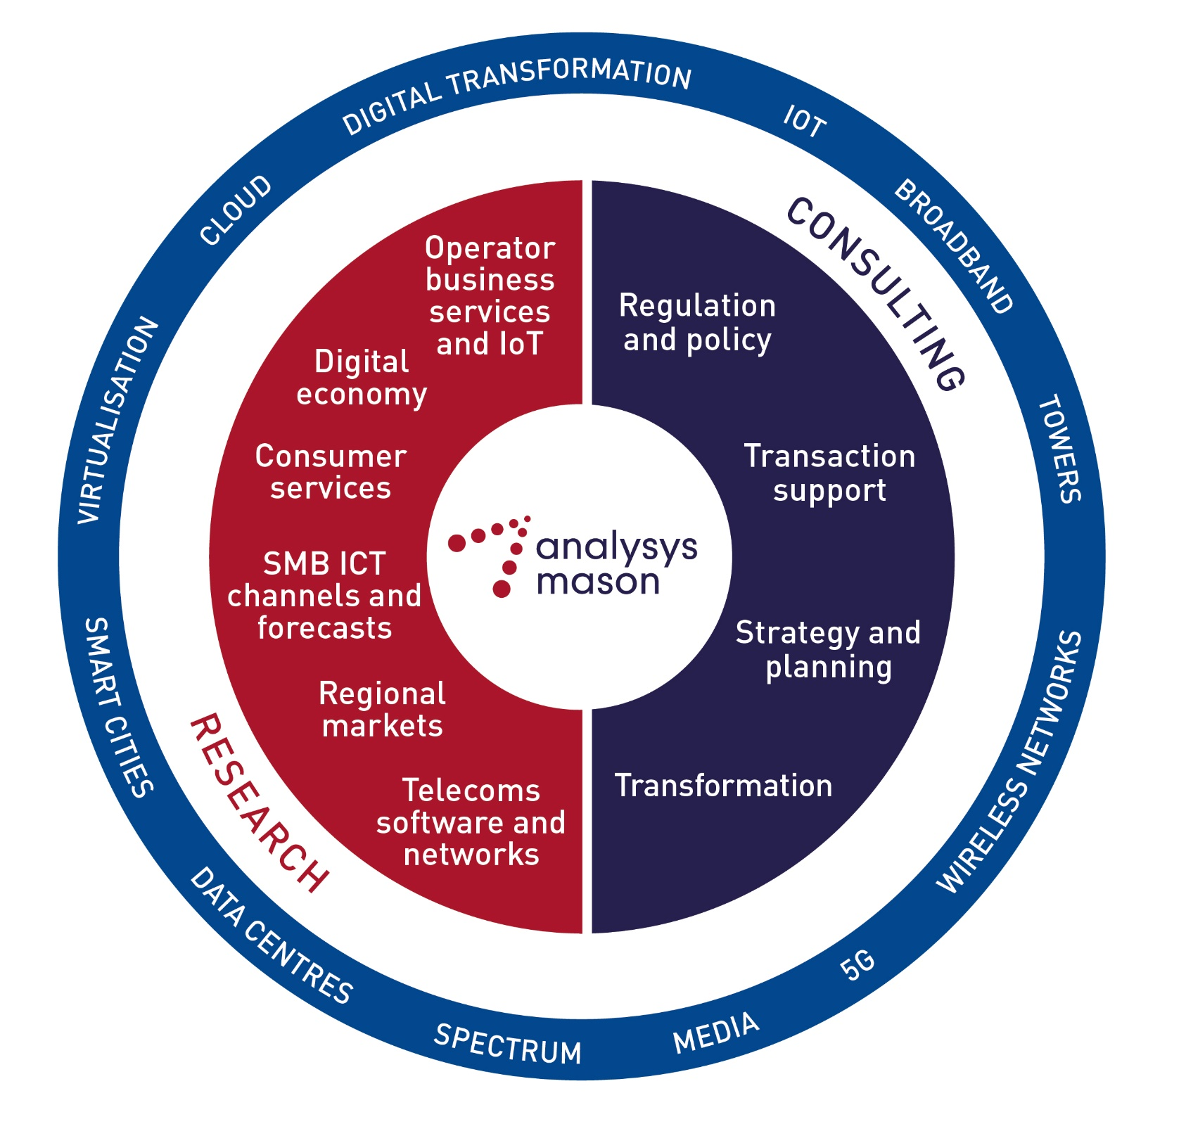
Analysys Mason’s consulting and research are uniquely positioned
Analysys Mason’s consulting services and research portfolio
Consulting
We deliver tangible benefits to clients across the telecoms industry:
  communications and digital service providers, vendors, financial and strategic investors, private equity and infrastructure funds, governments, regulators, broadcasters and service and content providers
Our sector specialists understand the distinct local challenges facing clients, in addition to the wider effects of global forces.
We are future-focused and help clients understand the challenges and opportunities new technology brings.
Research
Our dedicated team of analysts track and forecast the different services accessed by consumers and enterprises.
We offer detailed insight into the software, infrastructure and technology delivering those services.
Clients benefit from regular and timely intelligence, and direct access to analysts.

Slide 60
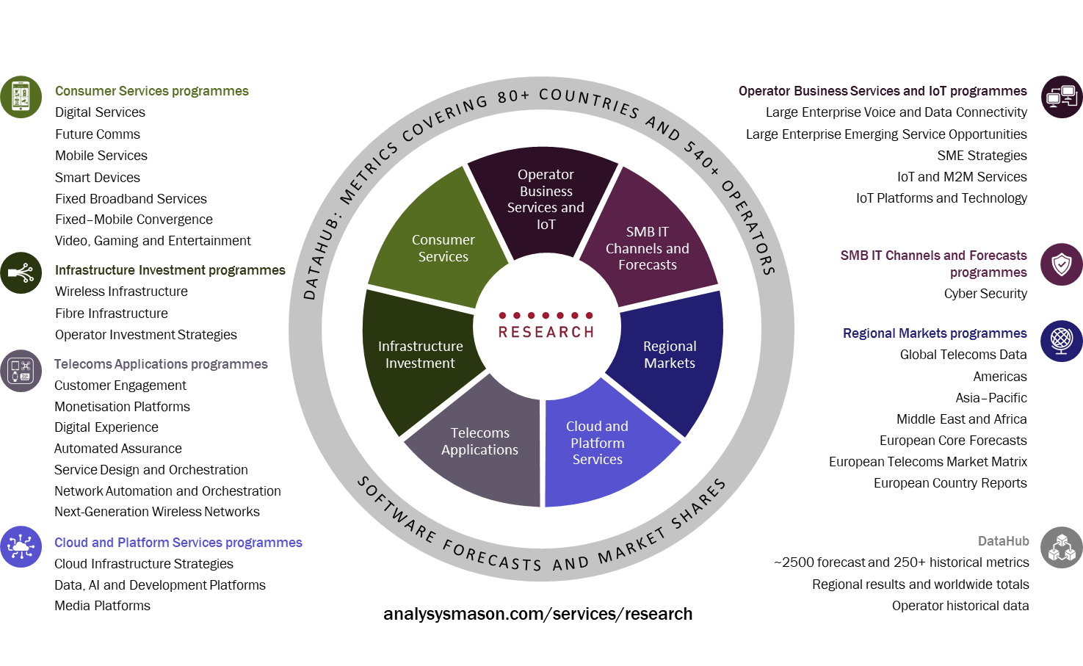
Research from Analysys Mason

Slide 61
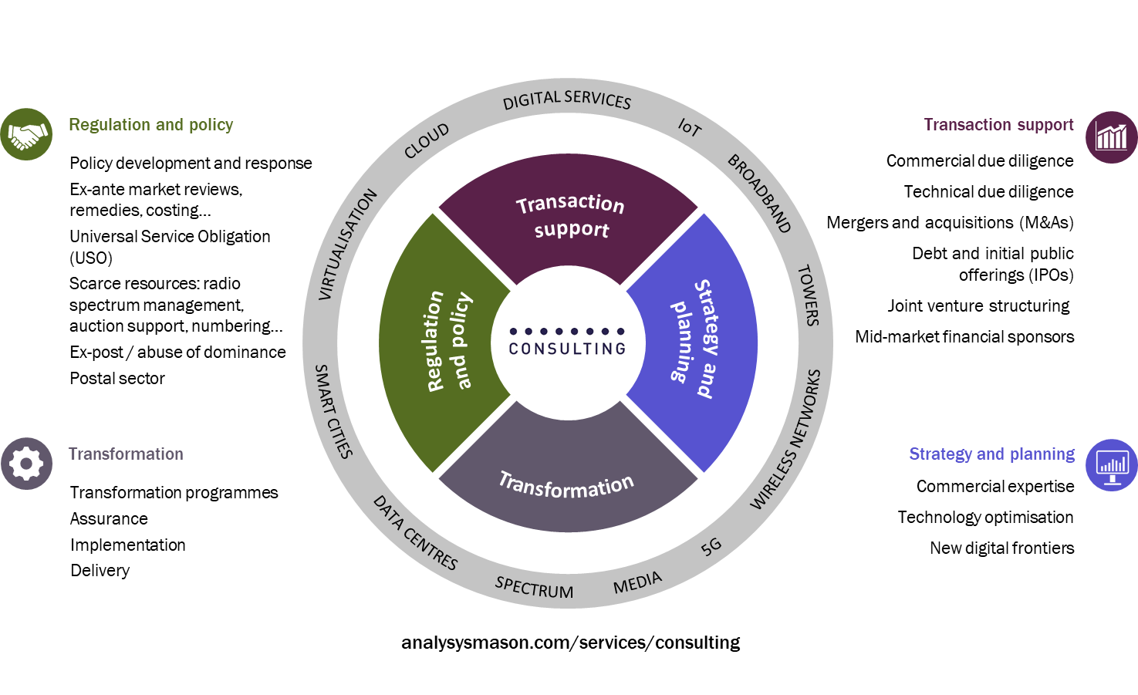
Our consulting expertise covers the breadth of TMT issues and challenges

Slide 62
SEPTEMBER 2020

