Slide 1
Monetisation platforms: worldwide market shares 2019
John Abraham

Slide 2
About this report
This report provides market share data for communications service provider (CSP) spending on telecoms-specific monetisation platforms software systems and related services for 2019. It provides details of how the spending varied by delivery model, service type, vendor and region. The report also includes profiles of the leading vendors in the market.
It is based on several sources, including:
  interviews with CSPs and vendors worldwide
  Analysys Mason’s research conducted during the past year.
GEOGRAPHICAL COVERAGE Worldwide Central and Eastern Europe Developed Asia–Pacific Emerging Asia–Pacific Latin America Middle East and North Africa North America Sub-Saharan Africa Western Europe | SUB-SEGMENT COVERAGE Billing and charging Policy management Mediation Partner and interconnect
What was the overall size of the market (monetisation platforms software systems for the telecoms industry) and what drove this spending among CSPs?
How did the spending vary across different sub-segments of the monetisation platforms market?
Who are the major vendors and what is their share of revenue in the monetisation platforms systems market?
What are the different drivers and growth rates of CSP spending on products and professional services?
Vendor strategy teams that need to understand where growth is slowing and where it is increasing across different sub-segment categories.
Product management teams responsible for feature functionality and geographical focus, and product marketing teams responsible for market-share growth.
Market intelligence teams at vendors that want to understand how their competitors compare to each other.
CSPs that are planning charging or billing system upgrades, particularly for 5G or as part of digital transformation initiatives.

Slide 3
Executive summary
Market shares
Overall telecoms market context
Vendor analysis
Market definition
About the author and Analysys Mason

Slide 4



A major overhaul of incumbent monetisation platforms is underway; legacy systems are being replaced by cheaper and more-efficient alternatives
The monetisation platforms segment is one of the most mature and mission-critical segments of the telecoms software systems market. The total revenue in this segment was USD18.6 billion in 2019, down by 1.6% year-on-year. However, this fall in revenue masks the significant changes that are taking place. CSPs are investing in modern monetisation systems to support new business cases and lower their operational costs. These new systems are cheaper and more-efficient than those currently in place, which helps to explain the continued revenue decline. Monetisation platforms investments were also affected by CSPs’ other priorities, such as network infrastructure improvements.
The billing and charging sub-segment accounted for over 62% of the total monetisation platforms revenue in 2019, mainly due to the substantial costs associated with the support and maintenance of legacy systems. CSPs favour a phased approach to transforming their billing and charging systems, but cloud-native compliance has become an essential pre-requisite for new system deployments.
Partner and interconnect revenue declined by 1.2% year-on-year in 2019. However, we expect this trend to change in the next few years as CSPs plan to add advanced capabilities in order to support complex multi-dimensional value chains. Policy management revenue also decreased in 2019, though there are signs of a new wave of investments driven by 5G. The market for mediation systems contracted by 2.8%, primarily because of the maturity of existing deployments.
Figure 1: Key drivers of the overhaul of incumbent monetisation systems
High support costs
The costs of supporting legacy platforms are unsustainably high and need to be reduced
Role of partners
Digital marketplaces and ecosystems will be vital for driving new revenue streams in the future
New revenue models
New technologies such as 5G will change CSPs’ business and operating models
Source: Analysys Mason

Slide 5
5G is driving a shift in how CSPs procure and deploy monetisation platforms
5G accounts for only a small share of the overall revenue in the monetisation platforms segment. However, it has been an important driver of new spending, particularly for medium-sized and large CSPs. The first 5G services are expected to be consumer-facing, but enterprise services are expected to provide far greater potential for new revenue in the medium-to-long term.
The lack of clarity regarding the type of enterprise use cases that 5G will support is a key concern for CSPs that are struggling to work out how to effectively monetise 5G applications (Figure 2). CSPs’ existing monetisation systems were designed to support mostly consumer use cases, with limited flexibility to support emerging enterprise ones. As a result, CSPs are having to alter their traditional models of procuring and deploying monetisation systems.
The overall impact of 5G on the various players in the monetisation platforms market can be summarised as follows.
  CSPs. 5G charging is an important issue that CSPs are working to address at the same time as their network launches, unlike in the past, where monetisation system upgrades trailed network roll-outs. As such, CSPs are shifting from a use-case centred approach to a model that emphasises configurability and architectural agility. CSPs are also favouring co-development models and are focusing on improving software competency internally.
Figure 2: Challenges of 5G monetisation
NEW USE CASES
Challenges
of 5G
monetisation
INCUMBENT SYSTEMS
Lack of clarity on what the compelling 5G applications will be
Disparate information silos and complex multi-vendor architecture frameworks
Lack of expertise in
partner-enabled ecosystem-centred businesses
Changing customer behaviour and new emphasis on enterprise applications
NEW BUSINESS MODELS
NEW CUSTOMER PROFILE
Source: Analysys Mason
  Product vendors. Cloud-native compliance is essential for selling to CSPs, while exposure to a DevOps delivery model is considered to be an advantage. Best of suite continues to be in favour for large transformations. CTO offices have become important stakeholders in the procurement process.
  Professional services providers. Opportunities around traditional integration and maintenance functions are limited for 5G-related investments. However, there is a growing demand for expertise in organisation and culture change.

Slide 6





Digital transformation continues to be an important driver of new monetisation platforms revenue
Legacy monetisation platforms continue to be a key concern for CSPs because they limit their ability to respond swiftly to competition and changing market requirements. In the past, monetisation platform upgrades and transformations were driven at the departmental level, which limited CSPs’ ability to experiment with new delivery models or adopt a uniform architecture framework. A growing number of new deployments are part of CSPs’ broader digital transformation initiatives, which are often organisation-wide, and a strong emphasis on lean operating models and cloud-based architecture frameworks. The most common delivery models for digital transformation projects are the following.
  Managed services. Managed services continue to be popular for both small and large transformation projects. CSPs are increasingly demanding cloud-native applications and co-operative models as part of their managed services contracts, which typically run for 4–5 years.
  SaaS. CSPs are considering SaaS-based solutions for niche and emerging applications, encouraged by the adoption of SaaS models in mission-critical applications in other industries.
  DevOps. CSPs seldom build and deploy CI/CD pipelines on their own, and are often reliant on vendor partners or service providers. CI/CD models within CSPs are mostly nascent, with limited support for continuous code drops.
Figure 3: Digital transformation strategies that have affected the development and deployment of monetisation systems
Internal streamlining
Emphasis on improving the software expertise and collaborative culture
Co-development
New models of external co-operation and co-development with partners
Open-source tooling
Strong emphasis on building open, standardised architecture frameworks
Phased approach
A multi-year multi-phase approach is the default for large transformation projects
Application refactoring
The decomposition of legacy applications is increasingly common
Source: Analysys Mason

Slide 7
Key recommendations
1
Vendors should prioritise the development of 5G-ready monetisation platforms because they have become increasingly important for engaging with medium-sized and large CSPs.
5G is the primary driver of CSP spending on new monetisation platforms. CSPs are all trying to ensure that any new platforms being deployed are capable of supporting emerging 5G business cases, even if they do not have immediate plans for rolling out 5G services.
2
CSPs should prioritise architectural agility and configurability to ensure that they will be able to effectively support as yet undetermined business cases in the future.
The high cost of supporting and maintaining legacy monetisation systems is forcing CSPs to prioritise cost reduction strategies. As such, CSPs are working to reduce customisation and increase standardisation. A cloud-based, flexible platform that can be configured to support new use cases will be advantageous.
3
Vendors should be prepared to change their business models as CSPs increasingly shift towards modern monetisation platforms that are more-efficient and cheaper to deploy and maintain.
The total monetisation platforms revenue continues to decline, but this masks the significant shift in the segment. CSPs are starting to replace their legacy monetisation systems with new systems that are cheaper to deploy, simpler to manage and require reduced support from vendors and other service providers.

Slide 8
Executive summary
Market shares
Overall telecoms market context
Vendor analysis
Market definition
About the author and Analysys Mason

Slide 9
Monetisation platforms revenue market share
Figure 4: Monetisation platforms total revenue by type, worldwide, 2019
Figure 5: Monetisation platforms total revenue by vendor, worldwide, 2019¹
PRODUCT
Total 2019:
USD18.6 billion
Year-on-year growth:
–1.1%
PROFESSIONAL SERVICES
Source: Analysys Mason
¹ Other vendors include Atos, Capgemini, CGI Group, CSG, HP Enterprise, IBM, Oracle, Tata Consultancy Services, Tech Mahindra and Wipro Technologies.

Slide 10
Monetisation platforms revenue market share
Figure 6: Monetisation platforms product revenue by vendor, worldwide, 2019¹
Figure 7: Monetisation platforms professional services revenue by vendor, worldwide, 2019¹
Total 2019:
USD5.73 billion
Year-on-year growth:
–0.2%
Total 2019:
USD12.9 billion
Year-on-year growth:
–1.6%
Source: Analysys Mason
Source: Analysys Mason
¹ Other vendors include Capgemini, CGI Group, Comarch, Infosys Technologies, Matrixx Software, Nexign, Optiva, Oracle, Tata Consultancy Services, Tech Mahindra, Wipro Technologies and ZTE.

Slide 11
Billing and charging product revenue market share
Figure 8: Billing and charging product revenue by vendor, worldwide, 2019¹
Figure 9: Product revenue and growth of top-six vendors compared to overall product revenue growth in the billing and charging market, 2019
Total 2019:
USD3.83 billion
Year-on-year growth:
0.8%
Source: Analysys Mason
¹ Other vendors include CGI Group, Comarch, Matrixx Software, Nexign, Nokia, Openet, Optiva, SAP and ZTE. We have revised upwards CSG’s 2018 product revenue in this sub-segment to account for revenue that was previously not considered to be related to telecoms billing and charging functions.

Slide 12
Billing and charging professional services revenue market share
Figure 10: Billing and charging professional services revenue by vendor, worldwide, 2019¹
Figure 11: Professional services revenue and growth of top-six vendors compared to overall professional services revenue growth in the billing and charging market, 2019
Total 2019:
USD7.84 billion
Year-on-year growth:
–2.5%
Source: Analysys Mason
¹ Other vendors include Atos, Capgemini, CGI Group, HCL Technologies, HP Enterprise, IBM, Infosys Technologies, Tata Consultancy Services, Tech Mahindra and Wipro Technologies.

Slide 13
Partner and interconnect product revenue market share
Figure 12: Partner and interconnect product revenue by vendor, worldwide, 2019¹
Figure 13: Product revenue and growth of top-six vendors compared to overall product revenue growth in the partner and interconnect market, 2019
Total 2019:
USD536 million
Year-on-year growth:
–0.6%
Source: Analysys Mason
¹ Other vendors include BearingPoint, Comarch, Ericsson, FTS, Mind CTI, Nexign, Sofrecom and Syniverse Technologies.

Slide 14
Partner and interconnect professional services revenue market share
Figure 14: Partner and interconnect professional services revenue by vendor, worldwide, 2019¹
Figure 15: Professional services revenue and growth of top-six vendors compared to overall professional services revenue growth in the partner and interconnect market, 2019
Total 2019:
USD2.15 billion
Year-on-year growth:
2.0%
Source: Analysys Mason
¹ Other vendors include Amdocs, Capgemini, CSG, Ericsson, HCL Technologies, HP Enterprise, Huawei, Infosys Technologies, Tata Consultancy Services and Wipro Technologies.

Slide 15
Policy management product revenue market share
Figure 16: Policy management product revenue by vendor, worldwide, 2019¹
Figure 17: Product revenue and growth of top-six vendors compared to overall product revenue growth in the policy management market, 2019
Total 2019:
USD707 million
Year-on-year growth:
–2.3%
Source: Analysys Mason
¹ Other vendors include Cisco, CSG, FTS, HP Enterprise, Nexign, Openet, Openwave Mobility, Sandvine, Tango Telecom and ZTE.

Slide 16
Policy management professional services revenue market share
Figure 18: Policy management professional services revenue by vendor, worldwide, 2019¹
Figure 19: Professional services revenue and growth of top-six vendors compared to overall professional services revenue growth in the policy management market, 2019
Total 2019:
USD1.29 billion
Year-on-year growth:
–0.2%
Source: Analysys Mason
¹ Other vendors include Amdocs, Atos, Capgemini, HCL Technologies, HP Enterprise, Infosys Technologies, Netcracker, Tata Consultancy Services, Tech Mahindra and Wipro Technologies.

Slide 17
Mediation product revenue market share
Figure 20: Mediation product revenue by vendor, worldwide, 2019¹
Figure 21: Product revenue and growth of top-six vendors compared to overall product revenue growth in the mediation market, 2019
Total 2019:
USD654 million
Year-on-year growth:
–3.0%
Source: Analysys Mason
¹ Other vendors include Comarch, Digital Route, Enghouse Systems, HP Enterprise, Nexign, Openet, Oracle and Sterlite Technologies.

Slide 18
Mediation professional services revenue market share
Figure 22: Mediation professional services revenue by vendor, worldwide, 2019¹
Figure 23: Professional services revenue and growth of top-six vendors compared to overall professional services revenue growth in the Mediation market, 2019
Total 2019:
USD1.63 billion
Year-on-year growth:
–2.6%
Source: Analysys Mason
¹ Other vendors include Amdocs, Capgemini, CGI Group, CSG, HCL Technologies, HP Enterprise, Huawei, Tata Consultancy Services, Tech Mahindra and Wipro Technologies.

Slide 19
Executive summary
Market shares
Overall telecoms market context
Vendor analysis
Market definition
About the author and Analysys Mason

Slide 20
Overall telecoms services: revenue split and trends for regional markets
Figure 24: Share of worldwide USD1.578 trillion telecoms service revenue and trends by region, 2019
NORTH AMERICA
32%
Fixed and mobile data service revenue growth will drive the total telecoms revenue growth.
5G take-up is expected to grow rapidly as 5G coverage improves and spectrum becomes available.
WESTERN EUROPE
19%
Fixed broadband household penetration will continue to grow in all countries.
The adoption of 5G will have a small impact on mobile revenue.
CENTRAL AND EASTERN EUROPE
5%
Mobile handset data and fixed broadband are the largest areas for revenue growth.
Operators will continue to invest in improving LTE network coverage and speeds.
DEVELOPED ASIA–PACIFIC
12%
Revenue growth will be driven by demand for gigabit access speeds.
The growing demand for 5G services and their rapid take-up will limit mobile ARPU decline.
LATIN AMERICA
6%
Growth in fixed broadband, mobile handset and pay-TV revenue will drive overall growth.
Investments in mobile and fixed infrastructure will increase.
5G will be launched in 2021.
SUB-SAHARAN AFRICA
2%
Mobile services will continue to generate the vast majority of telecoms revenue.
Rapid handset data revenue growth drive the overall telecoms revenue growth.
MIDDLE EAST AND NORTH AFRICA
4%
Fixed broadband revenue growth will offset the decline in traditional voice services revenue.
Spending on improving mobile data speeds and coverage will increase.
EMERGING ASIA–PACIFIC
20%
Pay-TV revenue will grow sharply, driven by improved internet coverage and speeds.
The mobile penetration rate is expected to grow strongly in countries with low starting bases.
Source: Analysys Mason

Slide 21
Overall telecoms services: regional service breakouts
Figure 25: Metrics for the eight regions modelled individually and worldwide, 2019
 | Population (million)¹ | GDP (USD billion)¹ | GDP per capita (USD thousand)¹ | Telecoms revenue |  |  |  | Mobile SIM population penetration² | Fixed broadband population penetration³
 |  |  |  | Mobile (USD billion) | IoT (USD billion) | Consumer fixed (USD billion) | Business fixed (USD billion)
North America | 367.6 | 23 172 | 63.0 | 202.3 | 3.4 | 192.8 | 102.6 | 106.2% | 34.6%
Latin America | 651.1 | 5 285 | 8.1 | 48.6 | 0.6 | 32.8 | 14.5 | 101.9% | 13.4%
Western Europe | 422.5 | 17 714 | 41.9 | 114.8 | 2.2 | 99.8 | 76.9 | 122.6% | 39.1%
Central and Eastern Europe | 407.9 | 4 473 | 11.0 | 39.4 | 0.9 | 16.6 | 14.8 | 132.9% | 22.3%
Developed Asia–Pacific | 247.0 | 9 775 | 39.6 | 102.4 | 1.3 | 48.6 | 42.3 | 130.7% | 34.9%
Emerging Asia–Pacific | 4072.7 | 20 773 | 5.1 | 218.6 | 5.4 | 64.1 | 28.5 | 96.4% | 12.6%
Middle East and North Africa | 459.5 | 3 639 | 7.9 | 42.6 | 0.4 | 12.4 | 9.6 | 107.8% | 7.5%
Sub-Saharan Africa | 1123.7 | 1 726 | 1.5 | 32.1 | 0.3 | 4.0 | 2.7 | 76.9% | 0.5%
Worldwide | 7751.9 | 86 556 | 11.2 | 800.9 | 14.5 | 471.2 | 291.8 | 99.6% | 14.3%
  Macroeconomic and general regional factors (such as population) provide significant context for the telecoms revenue figures that we track in the Analysys Mason DataHub. The availability of fixed broadband services remains limited in Latin America, emerging Asia–Pacific, the Middle East and North Africa and Sub-Saharan Africa because of the costs associated with infrastructure deployment and the low GDP per capita, both of which limit service affordability. Mobile SIM penetration in Sub-Saharan Africa is growing steadily, but remains considerably lower than 100% (it is close to, or above, 100% elsewhere). Almost 50 operators worldwide launched 5G services in 2019, and many more are preparing to do the same in 2020. Many 5G launches are associated with improved network capacity and data speeds, and several CSPs initially offered 5G in the form of fixed-wireless access broadband. CSPs in North America and developed Asia–Pacific are leading the 5G race, but those in emerging regions such as China are also moving quickly.
¹ Population and GDP data is from the Economist Intelligence Unit. The rest of the data are from Analysys Mason’s DataHub.
² Excludes IoT SIMs.
³ Total fixed broadband connections (including business) expressed as a share of population.

Slide 22
Overall telecoms services: regional service comparison
Figure 26: Overall telecoms revenue by region and service type, 2019
Source: Analysys Mason

Slide 23
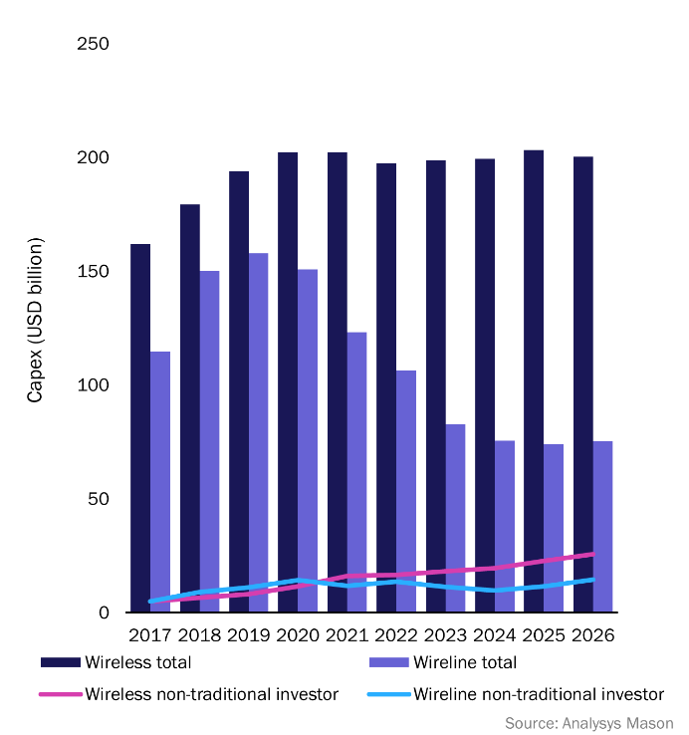
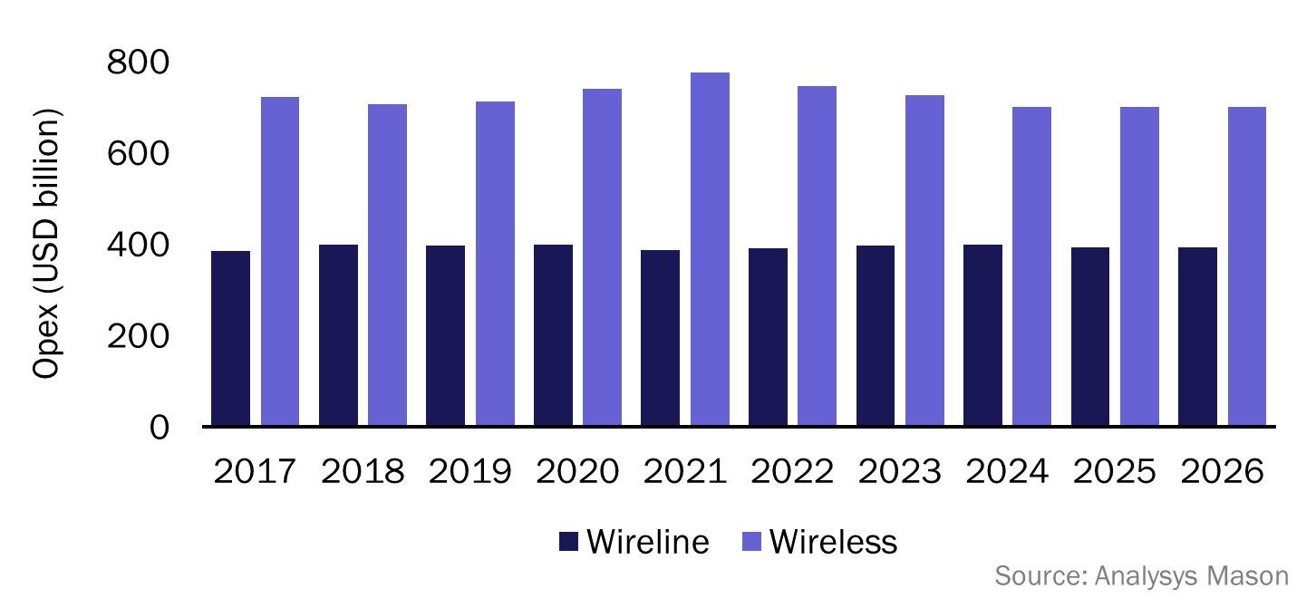
Overall telecoms services: investments and spending
Figure 27: Wireline and wireless capex (including that from non-traditional investors), worldwide, 2017–2026
Figure 28: Wireline and wireless opex, worldwide, 2017–2026
CSP spending on telecoms software is heavily influenced by both overall investment levels (capex) and overall expenses (opex).
Network capex was approximately USD350 billion in 2019, and telecoms software accounted for approximately USD52 billion of this (15%). CSPs are under increasing pressure to reduce opex and protect margins as revenue growth slows. This will lead to an increase in telecoms software spending in order to reduce operational costs through automation. Telecoms software capex as a percentage of the total software spend is falling because software technology is increasingly being delivered as a service.
Telecoms software opex was approximately USD25 billion in 2019 (2% of the total network opex).

Slide 24
Overall telecoms services: key industry drivers
Figure 29: key drivers of the telecoms software and services industry
Driver | Key elements | Discussion
5G | Converged core Cloud RAN Infrastructure investments Network slicing Optimising capex/opex | Investment in 5G is the biggest single factor driving the telecoms software and services industry. Such investments drive software spending for the network itself, for network orchestration and automation and for improvements to OSS and BSS.
Cloud | Moving current payloads to public cloud Cloud-native development Cloud technology for telecoms networks Platform data services/AI Edge computing | Cloud is disrupting the way in which all industries work, including telecoms. The biggest near-term issue is moving existing payloads to the cloud. However, there is a greater emphasis on using software offered as a service, generally in the public cloud and for new cloud-native development, including of the network itself.
Enterprise services | SD-WAN IoT ecosystems Cloud IT services Enterprise digital experience/self service Private 5G | CSPs are placing a greater emphasis on making money from enterprise services. There are a range of drivers including cloud IT services and IoT. SD-WAN provides lower costs and faster deployments, thereby enabling new use cases. Enterprises now expect self-service through a digital experience.
Digital transformation | Digital experience Automated customer journeys Cloud-loop automation/lower TCO Use of cloud services/SaaS Culture change (to be like cloud providers) | The telecoms industry has been pushing digital transformation for some time and is now getting significant pay-off. Nearly all CSPs have deployed and are improving digital customer channels. Increased levels of automation lower network operational costs. All this has been made possible by underlying changes to enable the use of cloud methods and more cloud services.
Network disaggregation | Impact of virtual networks Infrastructure capex changes Infrastructure as real estate Cell densification Private 5G | Digital transformation has led to network disaggregation. The full vertical integration of networks and services is no longer necessary nor always efficient. Investors such as towercos, fibrecos and hosting centres provide wholesale access to fundamental infrastructure used by many retail service providers.

Slide 25
Executive summary
Market shares
Overall telecoms market context
Vendor analysis
Market definition
About the author and Analysys Mason

Slide 26

Accenture
MONETISATION
PLATFORMS
www.accenture.com
1989
Accenture is a global professional services firm that offers consulting and operational services to multiple sectors, including banking, retail and telecoms.
Accenture offers a range of services to the telecoms sector, including strategy and business consulting, outsourced operations and systems integration services.
Its monetisation platform capabilities include support for convergent charging, billing support for enterprise customers and support for hybrid billing use cases.
It also offers support for the effective monetisation of digital economy services, including IoT/M2M, as well as an extensive array of use cases around billing and charging for all sizes of CSP.
Accenture has deployed monetisation platforms solutions at over 230 CSPs worldwide, which together support around 250 million subscribers.
It has also been involved in the support and development of digital transformation programmes at multiple Tier-1 CSPs, giving it experience in supporting CSPs that are beginning their journeys to become digital service providers (DSPs).
Digital transformation is driving CSPs to transform their workforces, which provides an advantage to companies such as Accenture that have experience in organisational change.
Nokia
Oracle
SAP
Dublin (HQ)
Focus on expanding its footprint worldwide.
Leading provider of professional services across multiple telecoms segments. Well-regarded expertise in integration, deployment and managed services as well as organisation and culture change.
The company will continue to expand and build relationships with established and emerging software vendors.

Slide 27
Amdocs
MONETISATION PLATFORMS
www.amdocs.com
1982
Amdocs is a leading software product and services company specialising in BSS and OSS for the telecoms, media and entertainment industries.
CES20 includes Amdocs’s microservices-based, 5G-ready charging and billing products targeting media and communications providers.
Amdocs RevenueONE is a cloud-native, open, agile solution for monetising 5G services, IoT and smart spaces and the digital ecosystem.
Amdocs CatalogONE is a cloud-native catalogue solution for BSS and OSS.
Amdocs Optima is a digital BSS suite covering care, commerce, billing and charging targeted at Tier-2/3 CSPs and MVNOs.
Amdocs Vindicia is a SaaS billing platform for managing the end-to-end subscription business lifecycle.
Amdocs also offers vendor-agnostic professional services.
Amdocs leads the monetisation platforms market by a wide margin.
Amdocs has more than 300 CSP customers worldwide. The top 10 customers account for 65% of Amdocs’s total revenue, which highlights Amdocs’s key role in the Tier-1 CSP segment, especially in developed regions.
Amdocs plans to position RevenueONE as the extensive, all-inclusive monetisation platform for leading-edge CSPs with large operations. It will position its Optima monetisation offering as an alternative for Tier-3–5 CSPs and MVNO/Es, especially in emerging markets.
Amdocs’s acquisition of Openet in 2020 has not been considered for this report.
AWS
Microsoft
Google
VMWare
Chesterfield, MO (HQ)
Amdocs serves over 350 communications, pay-TV, entertainment and media industry service providers across 85 countries.
Amdocs has evolved its portfolio to be a fully cloud-native, 5G-ready, open and modular microservices-based platform.
Amdocs has a diverse customer base supported by a broad portfolio of product offerings and is backed by competent professional services.

Slide 28
Aria Systems
MONETISATION PLATFORMS
www.ariasystems.com
2002
Aria Systems
is a provider of cloud-based billing solutions for telecoms operators and enterprises.
Aria’s cloud billing and monetisation platform is a fully cloud-hosted solution for enterprises and telecoms operators that includes support for billing, provisioning and servicing of products.
The Aria platform offers support for complex hierarchies and subscription linkages at multiple levels for IoT use cases. It also supports devices independently of accounts and is designed to record and process non-billable IoT records.
The company’s focus is to provide end-to-end monetisation platforms for enterprises and operators that support both B2B and B2C customers.
Aria’s platform offers integration with a broader ecosystem of platforms including ERP, CRM, e-commerce and taxation.
The company is focusing on developing APIs for legacy telecoms systems. It can offer out of the box integration to a number of legacy billing systems, which is a key differentiator and an advantage over other cloud-based billing vendors.
IoT monetisation use cases are a sweet spot for the company because telecoms operators appear to be keen to engage with purely cloud-based billing vendors that can offer a rapid time to market for new product launches.
Deloitte
Salesforce
Matrixx
San Francisco, CA (HQ)
The company is focused on large enterprises, including CSPs, in developed markets.
Aria will use its cross-industry expertise and invest in its platform to increase the coverage of IoT, OTT and use cases beyond the telecoms vertical.
Focus on partnering with product vendors and service providers to expand footprint among CSPs.

Slide 29
Atos
MONETISATION PLATFORMS
www.atos.net
1997
Atos offers business consulting services to multiple industry verticals including banking, retail, healthcare and telecoms.
Atos has positioned its services to support CSPs’ digitalisation strategies. These services focus on:
  customer experience
  operational excellence
  trust and compliance
  business reinvention.
Atos has a fully integrated analytics solution, Atos Codex, which is aimed at supporting CSPs’ digital transformations by analysing customer usage and network data in real time to drive revenue-generating opportunities.
Atos’s main customer base is in North America and Western Europe, but it has multiple subsidiaries worldwide, which it will use to expand further.
It has a strong testing services business and is prioritising telco digital transformation initiatives.
Atos will need to invest in developing partnerships to increase its penetration among large CSPs.
Oracle
SAP
Siemens
Bezons, France (HQ)
It has focused on North America and Western Europe, but aims to expand to other regions.
Positions its professional services offerings to support CSPs’ digital transformation and cloud projects.
It will aim to cross-sell through its international subsidiaries.

Slide 30
BearingPoint//Beyond
MONETISATION PLATFORMS
www.bearingpointbeyond.com
2017
BearingPoint//Beyond was launched in 2017. It brings together BearingPoint’s BSS and digital business platform (DBP) solutions and services based on Infonova.
Infonova BSS supports traditional telecoms use cases using a SaaS or on-premises model.
Infonova DBP supports new business models that use a partner ecosystem for the co-creation of new digital services that are sold with or without CSP connectivity. DBP is mostly sold as SaaS.
InfonovaGo, offered as SaaS, is a cross-industry cloud-based billing solution.
BearingPoint//Beyond
is a digital platform solution and services provider that serves a global customer base, primarily in the telecoms industry
The company is primarily positioning itself to support CSPs’ ambitions to adopt a platform-based business model.
BearingPoint//Beyond places a strong emphasis on rapid revenue growth through a focus on agile and iterative ways of working and using its partner ecosystem for co-innovation.
From a technology standpoint, the company is investing in broadening the scope and functionalities of its application, while relying on AWS for middleware and compute and storage infrastructure.
The company has faced challenges in expanding beyond its core market regions and application types.
AWS
Graz (HQ)
BearingPoint//Beyond is primarily focused on Europe, North America and APAC.
The company’s portfolio helps clients to reinvent their business models to grow revenue. It helps CSPs to get a fast start in co-creating new multi-partner solutions.
It works with leading global systems integrators and tech providers, but also with CSPs’ in-house IT teams. The company also partners with cloud-based ICT, AI and technology providers.

Slide 31
CGI Group
MONETISATION PLATFORMS
www.cgi.com
1976
CGI Group
is a Canadian provider of IT consulting, systems integration and business process outsourcing services to enterprises and telecoms
operators.
Its cloud-based billing solution is based on CGI’s Tapestry cloud billing offering.
The CGI Tapestry solution offers convergent rating, billing and order management services.
CGI offers systems integration and application management services for mediation systems by partnering with vendors such as Digital Route.
The company offers consulting and system integration services for billing and charging use cases, with support from partners such as Oracle and SAP.
INTransit is a mobile roaming billing solution that provides support for roaming partner billing use cases.
Key customers include Bell Canada, Bell Mobility, Orange and Telenor Group.
It offers a wide portfolio of solutions within the monetisation platforms segment by partnering with multiple small and large product vendors.
CGI will need to offer greater differentiation and value to CSPs, as some of the larger billing vendors are expanding their services businesses.
Oracle
SAP
Montreal (HQ)
Europe, the Middle East and Africa (EMEA) accounts for around two thirds of its revenue; most of the rest comes from North America.
It has a strong focus on CSP transformations and becoming a preferred digital transformation services partner for CSPs.
It will continue to expand its partner relationships, with a strong focus on developed regions.

Slide 32
Comarch
MONETISATION PLATFORMS
www.comarch.com
1993
Comarch is a global software house that delivers and integrates proprietary IT products for enterprises worldwide.
Comarch’s telecoms solutions portfolio supports end-to-end transformation programmes in the BSS, OSS and service assurance areas.
For BSS, Comarch’s offerings include billing, charging, revenue management, omnichannel customer experience and an IoT connectivity management platform.
For OSS, Comarch focuses mostly on 5G network operations, SDN/NFV orchestration, resource management and service design and fulfillment.
Comarch has strong delivery capabilities, primarily for integrating its portfolio within a telecoms environment.
Comarch is considered to be a cost-effective full stack alternative to leading vendors, especially in emerging markets.
The company has well-regarded professional services capabilities and prefers to manage the integration of its portfolio within the CSP environment.
The company continues to achieve steady growth in its telecoms business, even as it expands into new verticals.
Salesforce
SAP
Kraków, Poland (HQ)
CSG serves over 350 communications and media customers globally with multiple regional support and development centers
It has a focus on full-stack solutions, even as it continues to use its modular portfolio and delivery capabilities to win new clients.
The company mostly relies on direct sales channels and a handful of local partners for delivery.

Slide 33
CSG
MONETISATION PLATFORMS
www.csgi.com
1994
CSG is a major
provider of customer engagement solutions that help companies to acquire, monetise, engage and retain customers.
CSG Ascendon is a cloud-based monetisation and engagement platform for digital services that supports multiple business lines.
The CSG Singleview suite provides an integrated customer care, billing and real-time rating and charging solution, and can be delivered either on-premises or in a cloud-hosted environment.
Advanced Convergent Platform (ACP) is a pre-integrated billing and customer care platform for cable and satellite providers.
CSG Digital Mediation supports offline and real-time mediation requirements.
CSG Digital Wholesale, a partner management and settlements system, is delivered in either a cloud or standalone environment.
CSG is focussing on a productised, cloud-first, DevOps-ready strategy to expand its footprint.
With CSG Ascendon, the company is positioned to address the growing digital services segment, with flexible, cost-optimised solutions that can enable CSPs to experiment with next-generation business models.
CSG Singleview remains an important part of the portfolio, helping to deliver complex, multi-play monetisation solutions on a configuration-based platform.
CSG also has a well-regarded mediation and wholesale platform that continues to be widely deployed worldwide.
Microsoft
AWS
Deloitte
Greenwood Village, CO (HQ)
CSG serves over 350 communications and media customers globally with well-established regional support and development centres.
CSG is focused on cloud-first, cloud-native architecture. SaaS underpins the vast majority of CSG’s products.
CSG continues to expand into other verticals including financial services, media and entertainment and healthcare.

Slide 34
Ericsson
MONETISATION PLATFORMS
www.ericsson.com
1876
Ericsson is a major equipment, software and services company that serves multiple industry verticals, including telecoms.
Ericsson’s Digital BSS is a modular platform that includes billing, charging, mediation, access, finance, product catalogue and order care.
Ericsson’s charging product accounts for most of its customers and is supported by the billing product. Together with Catalog Manager, these form a convergent, end-to-end monetisation platform.
Ericsson Mediation is a convergent data mediation solution that handles file, event and online mediation.
Since the restructuring of its digital BSS business in 2019, Ericsson has seen increased traction for its monetisation portfolio. Ericsson’s portfolio is well-positioned for emerging 5G opportunities thanks to the company’s role as an NEP with a well-regarded charging solution.
Ericsson is well-connected to different buying centres within CSPs due to its extensive networks portfolio.
The company has a well regarded managed services business, which continues to grow.
Ericsson continues to have a strong brand and worldwide channel coverage. It has a very strong worldwide sales force that provides direct sales support.
Accenture
TCS
Capgemini
Stockholm (HQ)
Ericsson will continue to focus on growth in emerging markets as sales in mature markets slow down.
The company will focus on 5G and digital transformation with a greater emphasis on the continuity and extension of existing systems along with associated professional services.
Ericsson intends to cross-sell and upsell to its established large CSP customers in order to develop deeper relationships with them.

Slide 35
Huawei Technologies
MONETISATION PLATFORMS
www.huawei.com
1987
Huawei has a broad telecoms software portfolio that includes convergent charging, billing, policy and partner management solutions.
Huawei’s Business Enabling System (BES) is its next-generation portfolio of customer-facing telecoms software systems that focuses primarily on supporting CSPs’ digital transformations.
The company is also investing in developing cloud-based BSS stacks for enterprise-focused use cases.
Huawei Technologies
is the largest telecoms equipment manufacturer in the world, providing operational and consulting services.
Huawei remains a provider of monetisation solutions, but its revenue growth in this segment has been impacted by the company’s focus on productised cloud-based platforms. Geo-political factors have also played a role.
Huawei continues to serve its multiple monetisation platform customers, but the company has increased its focus on providing cloud-based platforms for B2B use cases.
Huawei’s early monetisation platforms implementations were heavily customised. There is a greater emphasis on standardisation in recent deployments.
Accenture
SAP
Shenzhen (HQ)
Huawei has always been strong in China. The company is increasing focus on emerging markets of Asia, Africa and Latin America.
Its portfolio spans the entire breadth of the monetisation platforms segment, with a strong emphasis on B2B use cases.
Huawei is increasing its focus on digital transformation through managed services as well as cloud-based deployments.

Slide 36
IBM
MONETISATION PLATFORMS
www.ibm.com
1911
IBM is a global technology firm that is a leading provider of cloud computing and business consulting services to enterprises worldwide.
IBM’s telecoms solutions focus around:
    customer experience
    operational efficiency
    network optimisation.
For customer experience, IBM offers customer engagement and digital interactions.
For operational efficiency, IBM offers support for end-to-end BSS transformation projects.
For network optimisation, it offers support for OSS transformation.
The company continues to play a role in the monetisation platforms segment by virtue of its broad SI and consulting experience and deep relationship with CSPs.
It is using its analytics and deep search capabilities (Watson) for multiple verticals, including telecoms.
It is a strong e-commerce player in the enterprise market and is applying this experience to expand in the telecoms sector.
Amdocs
Oracle
SAP
Armonk, NY (HQ)
It has a global footprint, and will continue to focus on delivering to its customers worldwide.
It will use its analytics and business process optimisation expertise to serve telecoms software segments.
IBM will continue to use its relationships with, and business strategy expertise in, other sectors to expand in the telecoms market.

Slide 37
MATRIXX Software
MONETISATION PLATFORMS
www.matrixx.com
2009
MATRIXX Software is a provider of digital BSS technology to CSPs worldwide.
The MATRIXX Digital Commerce Platform is a rating and charging engine that provides support for 5G CCS and 4G OCS. The platform provides commerce support across consumer, wholesale, enterprise, NaaS, private networks and multi-brand environments.
MATRIXX 5G Converged Charging System is a cloud native platform that offers primary 5G integrations for CHF, NRF, AMF, SMF, PCF, NEF and NWDAF functions.
MATRIXX has a well regarded cloud-native charging engine that is deployed by multiple Tier-1 CSPs. It has a range of technology partnerships with SIs and vendors.
The company is positioning itself as one of the leading vendors of 5G-ready charging systems.
MATRIXX has attracted investment from leading CSPs, such as Swisscom and Telstra, which has provided it with traction in the market.
MATRIXX is reliant on technology and delivery partners in order to sell and deliver solutions to CSPs that are deploying broader solution suites.
Salesforce
Tech Mahindra
Saratoga, CA (HQ)
The company already has major customers in NA, Europe, the Middle East and APAC, and is aiming to forge relationships in new markets.
It is working to operate in a multi-vendor ecosystem and will therefore aim to marry its software with other industry-leading technology.
MATRIXX is developing technology and delivery partnerships to improve channel coverage and widen its reach.

Slide 38
Netcracker
MONETISATION PLATFORMS
www.netcracker.com
1993
Netcracker,
a wholly owned subsidiary of NEC, is a
leading provider of BSS, OSS and SDN/NFV specialising in monetisation platforms and network management.
The Netcracker 2020 portfolio is a full-stack modular communications infrastructure solution that supports OSS and BSS functions. The platform is 5G ready and cloud-native compliant.
Netcracker 2020 covers two BSS product segments:
  Digital BSS which includes customer, revenue and partner management.
  Customer Engagement which includes channel, customer journey and marketing management.
Netcracker also has platform management and analytics capabilities available across their portfolio.
Netcracker 2020’s key value propositions focuses on 5G, partner based economy and support for standardisation and multi-cloud adoption.
The company registered strong revenue growth in 2019, driven by upgrades and new deals.
Netcracker has a strong presence in developed Asia–Pacific, due to NEC’s extensive channels and strong brand.
Netcracker only focuses on providing SI work for its own products. The company continues to rely on parent NEC for professional services resources on a need-only basis.
T-systems
Atos
HPE
Waltham, MA (HQ)
The company has a worldwide focus, backed by NEC’s large services team.
Netcracker has a strong focus on cross-selling billing solutions to its installed base of customers.
It plans to pursue up-sell opportunities with existing customers, while also using NEC’s footprint to expand its customer base.

Slide 39
Nexign
MONETISATION PLATFORMS
www.nexign-systems.com
1992
Nexign Network Monetisation (NWM) suite is a 5G-ready suite for real-time rating, charging, policy and session control. NWM includes multiple pre-integrated modules such as OCS, PCRF, UDR, and SCEF.
Nexign’s Digital BSS suite is a convergent pre-integrated offering that covers core BSS functions running as microservices within containers in elastic Kubernetes environment using DevOps processes and continuous delivery workflows.
Nexign IoT Platform is a telco-grade connectivity management platform, delivering vendor-agnostic integration with BSS solutions, supports eSIM and Non-IP Data delivery in NB-IoT use-cases.
Nexign (formerly known
as Peter-Service) is a leading provider of telecoms software and services for CSPs.
Nexign has a strong portfolio of offerings and a dominant position in the Commonwealth of Independent States (CIS) region. The company has gained critical experience from working with a number of CSPs including large digital transformation projects for Tier 1 CSPs.
The company has focused on telecom segment while expanding its presence in emerging markets.
Nexign registered a strong growth in 2019 delivering a 38% increase in revenue from the new business, including international projects.
The company is positioning itself as a value leader that can provide modular transformation in a short timeframe.
IBM
Oracle
HP
St. Petersburg (HQ)
Nexign has a strong presence in the CIS region and is gaining a foothold in the MEA region. The company also intends to expand its business into emerging markets in Southeast Asia and Latin America.
Nexign will leverage 5G and eSIM technologies as the key drivers of product development and will continue to invest in strengthening its BSS portfolio organically and through partnerships.
Nexign prioritizes the growth of its global and regional partner network for maximizing its footprint in the target regions.

Slide 40
Nokia
MONETISATION PLATFORMS
www.nokia.com
1865
Nokia develops and delivers the industry’s only end-to-end portfolio of network equipment, software, services and licensing to CSPs as well as enterprises in the private and public sector.
Nokia’s multi-vendor monetisation solution includes:
Nokia Converged Charging (formerly Smart Plan Suite) for real-time rating and charging
Nokia Policy Controller (formerly Smart Plan Suite) for seamless PCF/PCRF
Nokia Mediation (formerly Data Refinery), a fully convergent mediation system
Nokia Customer Insights for customer experience insights for monetisation purposes
links with technology partners to provide adjacent BSS capabilities
other services such as BSS transformation consulting, deployment and systems integration, BSS operations and managed services and BSS SaaS/PaaS offerings.
Nokia has streamlined and consolidated its monetisation offerings following several acquisitions.
Its monetisation solution is fully based on Nokia Software’s Common Software Foundation and Common Service Delivery Framework
The company made considerable investments to make its portfolio fully cloud-native compliant in 2020
Nokia’s monetisation solution does not have a billing or partner management platform; the company continues to rely on partners for this.
Nokia has a strong services division, but it increasingly works with SI partners to complement its offerings and gain access to new markets.
Salesforce
Accenture
IBM
Microsoft
Espoo (HQ)
Nokia has a worldwide focus.
The company has been investing in developing a monetisation platform that can be offered best-of-suite or best-of-breed.
Nokia is addressing CSPs of all sizes and increasingly enterprises, either directly or jointly with a growing ecosystem of partners.

Slide 41
Openet
MONETISATION PLATFORMS
www.openet.com
1999
Openet is a
provider of software solutions in the policy and charging and mediation segments for the telecoms industry.
Openet Evolved Charging is a 3GPP-compliant, 5G-ready online charging system that can be deployed on AWS. It integrates with a service control point in the core network to enable dynamic charging for voice and data.
Openet Policy Controller is a 5G-ready network policy management product that enables dynamic control of network resources with real-time policies.
Openet Digital Business Platform is an end-to-end Digital BSS platform for greenfield deployments.
Openet Data Fabric supports offline and online processing of data and mediation records and can function as a source feed for analytics applications.
A large percentage of Openet’s revenue comes from North America. Openet has also grown its revenue in LATAM and APAC in recent years.
The company has invested heavily in making its portfolio cloud-native compliant and has developed a library of microservices.
The company offers different options for BSS digital transformation including microservices-based co-development, adjunct systems, replacement systems and new stacks for greenfield sites.
Amdocs’s acquisition of Openet in August 2020 has not been considered for this report.
Aria Systems
Tech Mahindra
Samsung
Dublin (HQ)
Openet operates on a global basis and has customers and offices in EMEA, North America, APAC and the Caribbean and Latin America.
Openet has invested in cloud-native, microservices-based products that are open by design.
The company has an increasing focus on partnering with vendors of complementary solutions to provide an end-to-end, cloud-native stack.

Slide 42
Optiva
MONETISATION PLATFORMS
www.optiva.com
1999
Optiva
(formerly Redknee),
is a software provider of mission-critical, cloud-native, over-the-public-cloud monetisation solutions for CSPs worldwide.
Optiva’s Charging Engine is a cloud-native platform, designed with public-cloud principles and available as on a SaaS model.
Optiva Revenue Management Suite provides a private or public cloud-based end-to-end converged billing solution for tier-2, 3 and 4 CSPs, and MVNOs.
Optiva Policy Management solution provides a single solution that enables service providers to take control of network resource usage, assures quality of experience for users, and offers personalized services and differentiated, service-specific charging.
Optiva has a sizable number of existing customers across all tiers as a result of past acquisitions and wins.
The company has growing credentials and visibility as a cloud-native public-cloud SaaS based provider of monetisation systems.
The company has invested USD100 million in refactoring its products to be cloud-native compliant on the public cloud.
Optiva has announced new deals over the past year with Tier-1/2 CSPs with solutions deployed on public cloud. It is positioning itself for opportunities from CSPs that are embracing public cloud architecture models.
Google Cloud Platform
Mississauga, Ontario (HQ)
Worldwide focus.
Optiva is focused on supporting CSPs in their digital transformation journeys with cloud-native charging engine and/or full stack BSS platforms.
It plans to develop its relationships with Tier-1 CSP customers that it inherited from the Nokia BSS acquisition, as well as incumbent Tier-2/3 CSPs and MVNE/Os.

Slide 43
Oracle
MONETISATION PLATFORMS
www.oracle.com
1977
Oracle is one of
the world’s leading providers of enterprise software, and is a leading provider of BSS and OSS solutions for the telecoms industry.
Oracle Communications Billing and Revenue Management (BRM) is a cloud-native end-to-end monetisation platform for communications, IoT, cloud, smart-city and media service providers.
Elastic Charging Engine is BRM’s offline and online charging engine. It can rate any metric or attribute using an in-memory charging grid.
Oracle Network Charging and Control is an online charging solution for MVNEs/MVNOs in prepaid-dominant mobile markets.
Oracle Policy Management is a cloud-native converged policy solution to manage 4G and 5G network policies in an intuitive and consistent manner, while enabling seamless interworking and migration between 4G and 5G.
Oracle has a strong brand and broad product portfolio of enterprise- and telecoms-specific software, which ensures its relevance at multiple levels within CSPs.
Oracle’s BRM solution is widely deployed across a large number of CSP customers. The BRM solution was rearchitected to be cloud-native compliant and is the company’s primary offering in this segment.
Oracle has readied its portfolio for 5G with a roadmap that is aligned with the emerging specifications in the industry.
The company provides its own consulting services as well as a global network of certified partners to deploy and manage its solutions.
Accenture
Wipro
Covalense
Redwood City, CA (HQ)
Oracle is using its strong brand and extensive sales channels to expand its business worldwide.
Oracle has rearchitected its portfolio to be cloud-native compliant. The company is also increasing its focus on cloud-based delivery models.
Professional service providers remain an important channel to market for the Oracle monetisation portfolio.

Slide 44
Tata Consultancy Services (TCS)
MONETISATION PLATFORMS
www.tcs.com
1968
TCS is an
IT technology firm that offers professional services and BSS/OSS solutions for CSPs and other industry verticals.
Tata Consultancy Services is a USD22 billion IT services and consulting firm headquartered in India. The company ahs a large practice providing professional services to CSPs worldwide.
HOBS (Hosted BSS/OSS) is the TCS’s cloud native, multi tenant, digital subscription management platform for communications service providers (CSPs) and enterprises.
TCS HOBS supports industry standard business processes and TMF compliant Open API’s out of the box and is designed to enable ecosystems and subscription models. Besides telco, the product has also been deployed in verticals such as manufacturing, utilities and retail.
The company has a strong brand, extensive sales channels and relationships with CSPs of all sizes worldwide.
HOBS provides a broad portfolio coverage in BSS/ OSS with a modular portfolio that is microservices based and offers support for DevOps frameworks.
TCS faces a conflict of interest in its relationship with its product partners, even as it expands its own competing portfolio of solutions.
Avaya
Oracle
SAP
Mumbai (HQ)
The company will continue to focus on expanding its global footprint.
It will enhance its service offerings to support CSPs’ digital transformation needs and moves to the cloud.
It will continue to expand its partner relationships in adjacent areas of telecoms.

Slide 45
Tech Mahindra
MONETISATION PLATFORMS
www.techmahindra.com
1986
Tech Mahindra,
part of the Mahindra Group, is a provider of IT services, network solutions and business process outsourcing services to CSPs.
Mahindra Billing-as-a-Service (MBaaS) is a cloud-hosted billing platform that supports cross-vertical billing services. It includes various readily available billing services such as interconnect billing, subscription-based billing, CSP infrastructure billing, retail billing and convergent charging. It also supports customised billing services.
Tech Mahindra also offers support for billing transformation services through an SID-based design approach that is built on top of its Tech Mahindra Analytics Platform (TAP).
The company focuses on telecoms and has over 150 active customer engagements. Notable customers include AT&T, BT, Base Company, KPN and Three UK.
The company is positioned as a cost effective provider of professional services provider.
The maturity of its product portfolio is eroding SIs’ opportunities.
Some of its partner vendors are expanding their service offerings, thus competing directly.
It has used the Comviva acquisition to build on value-added services and mobile money capabilities.
Amdocs
Oracle
Pune(HQ)
EMEA remains Tech Mahindra’s strongest region, followed by North America and Asia–Pacific. Emerging markets remain a strong focus.
It has a specific focus on transformation projects and hosted services.
It will continue to expand its partner relationships, with a strong focus on emerging markets.

Slide 46
Summary of other players in the monetisation platforms market
Figure 30a: Other players in the monetisation platforms market
NAME | DESCRIPTION | WEBSITE
AsiaInfo | AsiaInfo is a China-based BSS/OSS vendor that offers monetisation platforms services for the telecoms industry. | www.asiainfo.com
Cerillion | Cerillion is a provider of billing, charging and customer management systems. It was formed in 1999 following the management buyout of the in-house customer care and billing product division of Logica. | www.cerillion.com
CHR Solutions | CHR Solutions provides a range of technology solutions to CSPs. Its flagship offering is the Omnia 360 suite, which is a pre-integrated customer relationship management and billing solution. | www.chrsolutions.com
DigitalRoute | DigitalRoute is based in Stockholm and provides mediation and data integration solutions. It has a growing mediation platform business and has partnered with several SIs and billing vendors. | www.digitalroute.com
Enghouse Systems | Enghouse Systems is a Canadian software and services company founded in 1984. Its business unit is focused on software for CSPs, and also provides software for transport. | www.enghouse.com
FTS (part of Magic Group) | FTS is a provider of convergent billing, charging, customer care, policy control and payment software solutions. The company is based in Israel and has deployments in 50 countries. | www.fts-soft.com
SAP | SAP provides a strong cross-industry software platform for a wide variety of back-office applications. SAP’s monetisation platforms solutions include convergent billing and mediation platforms. | www.sap.com
Sicap | Sicap is a provider of BSS software to mobile CSPs. It was founded in 1994 and has more than 40 CSP customers. It is owned by the Volaris Group today. | www.sicap.com
Subex | Subex is a provider of BSS software to CSPs. Its monetisation platforms offering includes products for partner and interconnect settlements. The company has over 300 installations in 70 countries. | www.subex.com

Slide 47
Summary of other players in the monetisation platforms market
Figure 30b: Other players in the monetisation platforms market
NAME | DESCRIPTION | WEBSITE
SunTec | SunTec is a provider of monetisation platforms and business assurance solutions to financial communications service industries. SunTec has clients in 60 countries including AT&T, Comcast and KPN. | www.suntecgroup.com
Syniverse Technologies | Syniverse is a leading provider of mobile roaming and data clearance and settlement services. The company connects more than 1500 CSPs in 200 countries. | www.syniverse.com
Tango Telecom | Tango Telecom is a provider of BSS solutions for data monetisation. The company was founded in 1999, is based in Ireland and has several Tier-1 CSP customers. | www.tangotelecom.com
Tecnotree | Tecnotree is a worldwide provider of telecoms software solutions for managing products, customers and revenue. Its monetisation platforms portfolio includes solutions for convergent charging and billing and wholesale billing. | www.tecnotree.com
Tomia (previously StarHome Mach) | Tomia is a provider of mobile roaming and data clearance and settlement services. The company is headquartered in Luxembourg and was formed from the merger of MACH and StarHome in 2013. The company merged with Telarix, a provider of business optimisation and settlement software, in 2018. | www.tomiaglobal.com
Whale Cloud (formerly ZTEsoft Technology) | Whale Cloud’s monetisation platforms portfolio includes solutions for convergent billing, data monetisation and enterprise billing. | www.iwhalecloud.com

Slide 48
Executive summary
Market shares
Overall telecoms market context
Vendor analysis
Market definition
About the authors and Analysys Mason

Slide 49
Definition of geographical regions
Figure 31: Regional breakdown used in this report
North America
Western Europe
Western Europe
Central and Eastern Europe
Latin America
Emerging Asia–Pacific
Middle East and North Africa
Sub-Saharan Africa
Developed Asia–Pacific

Slide 50
Telecoms software market segmentation¹
PRODUCTS
SYSTEMS INTEGRATION AND OTHER PROFESSIONAL SERVICES
DELIVERY MODELS
HOSTED/CLOUD
OUTSOURCED OPERATIONS
MONETISATION PLATFORMS
VIDEO AND IDENTITY PLATFORMS
CUSTOMER
ENGAGEMENT
SERVICE DESIGN AND ORCHESTRATION
AUTOMATED ASSURANCE
AI AND ANALYTICS
BILLING AND CHARGING
VIDEO MANAGEMENT
AND DELIVERY
ENGAGEMENT PLATFORMS
ORDER MANAGEMENT
SERVICE MANAGEMENT
REVENUE ASSURANCE AND FRAUD MANAGEMENT
PARTNER AND INTERCONNECT
MARKETING
INVENTORY MANAGEMENT
Intelligent Performance and Fault Monitoring
BUSINESS ANALYTICS
IDENTITY MANAGEMENT
NETWORK ANALYTICS
MEDIATION
SALES
ACTIVATION
WORKFORCE AUTOMATION
SUBSCRIBER DATA MANAGEMENT
DIGITAL INFRASTRUCTURE STRATEGIES
POLICY MANAGEMENT
CUSTOMER SERVICE
ENGINEERING SYSTEMS
PROBE SYSTEMS
EMS/NMS
VIRTUAL INFRASTRUCTURE MANAGERS
NFV
NETWORK AUTOMATION AND ORCHESTRATION
SDN
CONSUMER FIXED
NETWORK ORCHESTRATORS
WAN SDN
IoT
CLOUD COMPUTING
SERVICE TYPES
MOBILE
BUSINESS FIXED
¹ Note that Analysys Mason will be changing the coverage for some of its research programmes later in 2020. Please ask your account manager if you have any questions.

Slide 51
Monetisation platforms sub-segment definitions [1/2]
Figure 32a: Definitions of monetisation platforms and its sub-segments
SEGMENT OR SUB-SEGMENT | DEFINITION
MONETISATION PLATFORMS | Monetisation platforms include billing and charging systems, partner management and interconnect systems, policy management systems and mediation systems. These systems enable CSPs to track the use of their services, aggregate their records, compute charges, produce bills and process payments. The integrity of these systems is fundamental to CSP operations and crucial to the customer experience.
BILLING AND CHARGING | The billing and charging segment is formed of three different types of systems. Prepaid billing deployments are only used by retail subscribers that credit their account before using a service. The credit is debited in real time as the service is used, and service is denied if the balance falls to zero. Subscribers have various means of ‘topping up’ their balances. Prepaid service systems must be able to rate service usage in real time and maintain a real-time account balance. They must also be able to interact with the network to redirect subscribers to top-up servers if the account balance drops to zero. Note that convergent platforms used purely for prepaid use cases are considered to be prepaid. Postpaid billing deployments are used by retail subscribers that are billed each month for the service they have used. Traditionally, postpaid billing systems work offline, using a monthly billing cycle. Modern postpaid billing systems include the ability to monitor usage in real-time and have enhanced capabilities, such as advice of charges. Postpaid billing includes rating events and combining the rated events with other aspects of the bill, including recurring charges, taxes, fees and other items that are independent of rated usage. Note that convergent platforms being used purely for postpaid use cases are considered to be postpaid. Convergent billing deployments support both prepaid and postpaid subscribers. They may also support hybrid accounts in which, for example, a family has a single account and some members of the family use prepaid, while others use postpaid accounts.
POLICY MANAGEMENT | Policy management is the practice of applying traffic management techniques using rules based on subscriber profiles. Profiles and rules are defined centrally and distributed to the policy enforcement points in the network to control a subscriber’s traffic. In 3GPP standards, policy management is implemented by the policy and charging rules function (PCRF), and policy enforcement by the policy and charging enforcement function (PCEF). We exclude policy enforcement products from our definition of policy management, which focuses on the PCRF and its various proprietary enhancements.

Slide 52
Monetisation platforms sub-segment definitions [2/2]
Figure 32b: Definitions of monetisation platforms and its sub-segments
SEGMENT OR SUB-SEGMENT | DEFINITION
PARTNER AND INTERCONNECT | Partner and interconnect monetisation platforms are used for payments to and collections from service providers that co-operate with a CSP to provide services to its customers. This includes traditional voice termination (both fixed and mobile), roaming interconnection and interfaces (but not roaming service bureaux per se) and international route optimisation and settlements with traditional network operator partners and content providers.
MEDIATION | Mediation systems collect data from the network, format it and store it for specific uses, generally for billing systems, but also for various types of service assurance. We include all mediation in this segment. The mediation sub-segment now includes active mediation, which previously was included in the real-time charging (RTC) sub-segment of our service delivery platforms segment.

Slide 53
Definitions: products and professional services
Figure 33: Definitions of product and professional services revenue
TYPE | DEFINITION
OVERALL | We divide our coverage of telecoms software and related services into two broad categories: products and professional services.
PRODUCTS | Product revenue includes that from licensed software products (‘product’) and the closely related services (‘product-related services’); see the specific definitions on the following slide. The emergence of SaaS leads us to explicitly include the licences for SaaS products in our coverage of products.
PROFESSIONAL SERVICES | Professional services include all software-related services that are not explicitly tied to software products. This includes hosted/cloud, outsourced operations and systems integration and other services; see the specific definitions on the following slides. These definitions include all the professional services that we previously covered, but we have adjusted the definitions of particular areas to embrace cloud as a way to provide hosted IT services and to reduce the number of distinct sub-segments for professional services.

Slide 54
Definitions: overall view of delivery types
Figure 34: Definitions of delivery types
TYPE | DEFINITION
PRODUCT | Product revenue includes that from licence software and maintenance, as well as a proportion of SaaS revenue that reflects the value of the software product used to provide the SaaS service It also includes the proportion of the managed services revenue that reflects the value of the software product used to provide the managed services (see the ‘Definitions: revenue distribution associated with delivery types’ slide for more details). Product revenue also includes revenue from product-related services, such as installation, training and lifecycle management services related to a specific telecoms software deployment. This category also includes professional services related specifically to a supplier’s own product. These are services that only the product supplier will be able to provide in nearly all cases. Services related to third-party products are part of the systems integration sub-segment.
HOSTED/CLOUD | Revenue from hosted/cloud delivery services includes that that is attributed to the vendor that hosts the product for the CSP. The product can be supplied by the vendor using its own or third-party infrastructure. The product can be delivered through a private traditional or cloud-based site, or on a public cloud.
OUTSOURCED OPERATIONS | This category accounts for revenue that is associated with managing systems for CSPs. It includes business process outsourcing (BPO). This category also includes revenue generated from outsourced operations that are professional or specialist services provided by external suppliers’ human resources to operate and maintain a CSP’s assets, which can include all related operational responsibilities. This involves the transfer of operations from a CSP to external suppliers. In this scenario, the assets (systems and software) are owned by the CSP and reside in the CSP’s environment and the supplier manages the network from a CSP co-located site or other local or regional (for example, regional NOC) site. It includes responsibility for onsite operations and related activities in a particular country or region.
SYSTEMS INTEGRATION AND OTHER PROFESSIONAL SERVICES | This category covers all new development that is carried out uniquely for the CSP. This includes business consulting, design consulting, custom development and systems integration. Overall, systems integration accounts for the largest proportion of professional services, although any of the other areas may be the focus in any given deal.

Slide 55
Definitions: detailed explanation of ‘systems integration and other professional services’ [1/2]
Figure 35a: Definitions of the systems integration and other professional services delivery type
TYPE | DEFINITION
SYSTEMS INTEGRATION AND OTHER PROFESSIONAL SERVICES | SYSTEMS INTEGRATION | Systems integration concerns the services required to manage and deliver major telecoms software projects in the OSS, BSS, NFV/SDN software and other applications areas to meet CSPs’ specific requirements. These are services that go beyond the boundaries of a single product or suite (such items are covered in the product-related services segment), and involve other systems in the CSP environment in order to meet the project’s requirements. This category includes, but is not limited to: integration with third-party (other vendor or proprietary) data sources, systems and interfaces, including VNF onboarding and data analytics/AI-driven automation applications data loading and migration customisation and configurations of software extensions and modules (without coding) to provide customised software features and capabilities, such as network equipment adapters, point-to-point interfaces and enterprise application integration (EAI) detailed requirements, technical specifications and detailed designs integration testing, not normal unit and functional system testing, such as for the integration of open multi-vendor components into a full stack solution (for example for open RAN implementations) project management services. Services related to third-party products (not owned by the supplier) are included in this systems integration sub-segment.
 | BUSINESS CONSULTING | Business consulting describes advisory services in the areas of business process, workflows, organisation issues and strategic planning, such as how to enter a market or how to package a service. This includes, but is not limited to transformational strategy, business case development and ROI modelling, business process re-engineering and optimisation, organisation restructuring, optimisation and change management, assisting CSPs to develop new products and services to deliver to their subscribers (ranging from tariffs to value-added services), go-to-market strategies, regulatory compliance review and reporting requirements and marketing and campaign strategies.

Slide 56
Definitions: detailed explanation of ‘systems integration and other professional services’ [2/2]
Figure 35b: Definitions of the systems integration and other professional services delivery type
TYPE | DEFINITION
SYSTEMS INTEGRATION AND OTHER PROFESSIONAL SERVICES | DESIGN CONSULTING | Design consulting describes the provision of advisory design services prior to the implementation of a telecoms network, software and/or system in such areas as OSS, BSS and virtualised network or cloud architecture, automation, network planning and optimisation and data or information models. These services typically contribute towards developing requirements for procuring the systems and software needed. This category includes, but is not limited to network planning and optimisation designs for both fixed and mobile networks and their transition to virtual/hybrid networks, OSS, BSS, cloud and data analytics platforms, and integrated architectural design, developing technical requirement for tender documents, high-level migration plans and roadmapping, analysis of established systems, data modelling, high-level interface definitions and designs.
 | CUSTOM DEVELOPMENT | Custom development refers to telecoms software that is written specifically for an individual CSP, typically as a result of its ownership of legacy and proprietary systems, software or interfaces. It includes any development that requires coding to meet an unusual requirement, such as the development of a customised application store on an SDP or Microsoft .NET platform, an API for interfacing with legacy or proprietary systems, data migration scripts and custom plug-ins for VNF or NFV/SDN-related functional integration. This is internal development that is typically performed by large CSPs. The spending in this category only includes CSP spending on paying other firms for custom development, not the spending required for their own staff to do custom development. This includes some applications development management (ADM).

Slide 57
Definitions: revenue distribution associated with delivery types
Figure 36: Delivery types and typical associated revenue distribution
Delivery type | Supply and operations |  |  | Vendor revenue distribution
 | Who supplies the software? | Who runs the IT infrastructure? | Who leads the operations? | Product | Hosted/cloud | Outsourced operations
Managed services | Vendor | Vendor | Vendor | 40% | 15% | 45%
Managed services | CSP-controlled | Vendor | Vendor | 0% | 25% | 75%
SaaS | Vendor | Vendor | CSP | 70% | 30% | 0%
Traditional vendor | Vendor | CSP | CSP | 100% | 0% | 0%
In-house developed | CSP | CSP | CSP | 0% | 0% | 0%
Outsourced operations | CSP | CSP | Vendor | 0% | 0% | 100%
Outsourced operations | Vendor | CSP | Vendor | 30% | 0% | 70%
Hosted cloud delivery | CSP | Vendor | CSP | 0% | 100% | 0%

Slide 58
Definitions: service types
Figure 37: Definitions of service types
SERVICE | DEFINITION
MOBILE | Software- and professional services-related to mobile services for consumer and business, but excluding IoT. This includes software/services related to handset and mobile broadband service revenue. We have used a single category because business mobile support does not differ significantly in OSS/BSS from consumer support. In the future, we may add a category to include 5G-based edge computing applications that are wireless, but not necessarily mobile.
CONSUMER FIXED | Software and professional services related to consumer fixed retail services. Consumer fixed services primarily revolve around broadband data access; traditional PSTN is also included, but PSTN revenue and that for the related software and professional services is in steep decline. We have also included pay-TV services in this grouping.
IoT | Software and professional services related to IoT. This is a small business services category in terms of spending, but we expect it to grow. It includes CSP IoT connectivity revenue only for cellular and fixed (Wi-Fi and broadband) networks. LPWA-related revenue, typically offered by non-traditional providers, is not included.
BUSINESS FIXED | Software and professional services related to business services such as internet access, hosting services, IP VPN, Ethernet, managed IT services and wholesale carrier services (typically provided using physical or virtual IP/optical network elements or cloud-based software). Fixed IoT services are excluded. This sub-segment includes IP/optical transport and backhaul services.

Slide 59
Executive summary
Market shares
Overall telecoms market context
Vendor analysis
Market definition
About the author and Analysys Mason

Slide 60

About the author
John Abraham (Principal Analyst) leads our digital transformation research, including three research programmes: Customer Engagement, Monetisation Platforms and Digital Experience. His areas of focus include customer journeys and experience, the impact of 5G on BSS systems, telecoms enterprise opportunities, cost transformation, ecosystems and value chains, and micro-services-based architecture models. John has over a decade of experience in the telecoms industry. At Analysys Mason, he has worked on a range of telecoms projects for operators in Africa, Europe, India and the Middle East. Before joining Analysys Mason, he worked for Subex, a BSS vendor, and before that for Dell in India. John holds a bachelor's degree in computer science from Anna University (India) and an MBA from Bradford University School of Management (UK).

Slide 61
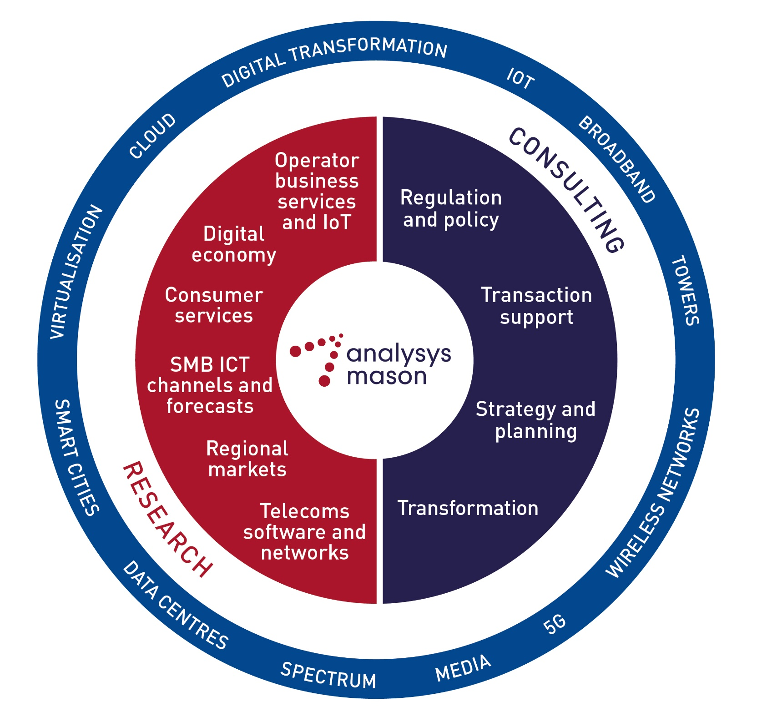
Analysys Mason’s consulting and research are uniquely positioned
Analysys Mason’s consulting services and research portfolio
Consulting
We deliver tangible benefits to clients across the telecoms industry:
  communications and digital service providers, vendors, financial and strategic investors, private equity and infrastructure funds, governments, regulators, broadcasters and service and content providers
Our sector specialists understand the distinct local challenges facing clients, in addition to the wider effects of global forces.
We are future-focused and help clients understand the challenges and opportunities new technology brings.
Research
Our dedicated team of analysts track and forecast the different services accessed by consumers and enterprises.
We offer detailed insight into the software, infrastructure and technology delivering those services.
Clients benefit from regular and timely intelligence, and direct access to analysts.

Slide 62
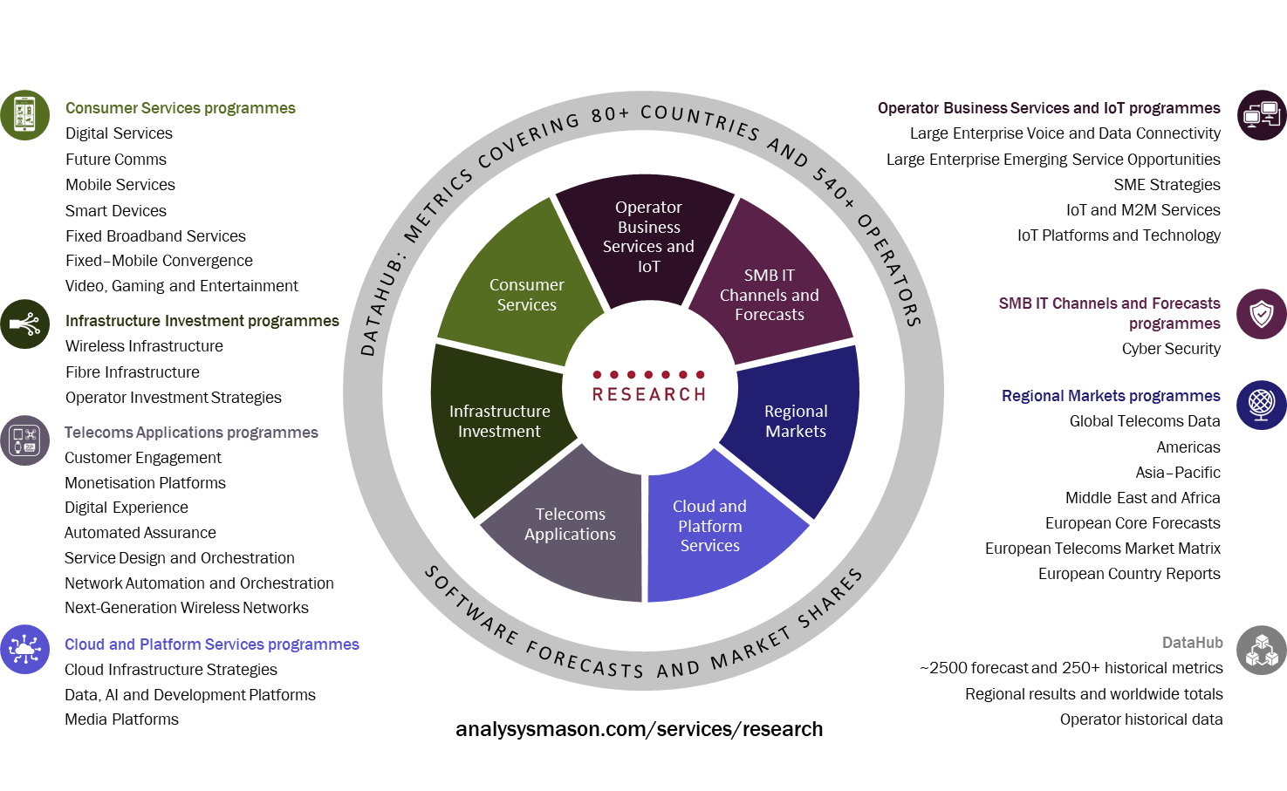
Research from Analysys Mason

Slide 63
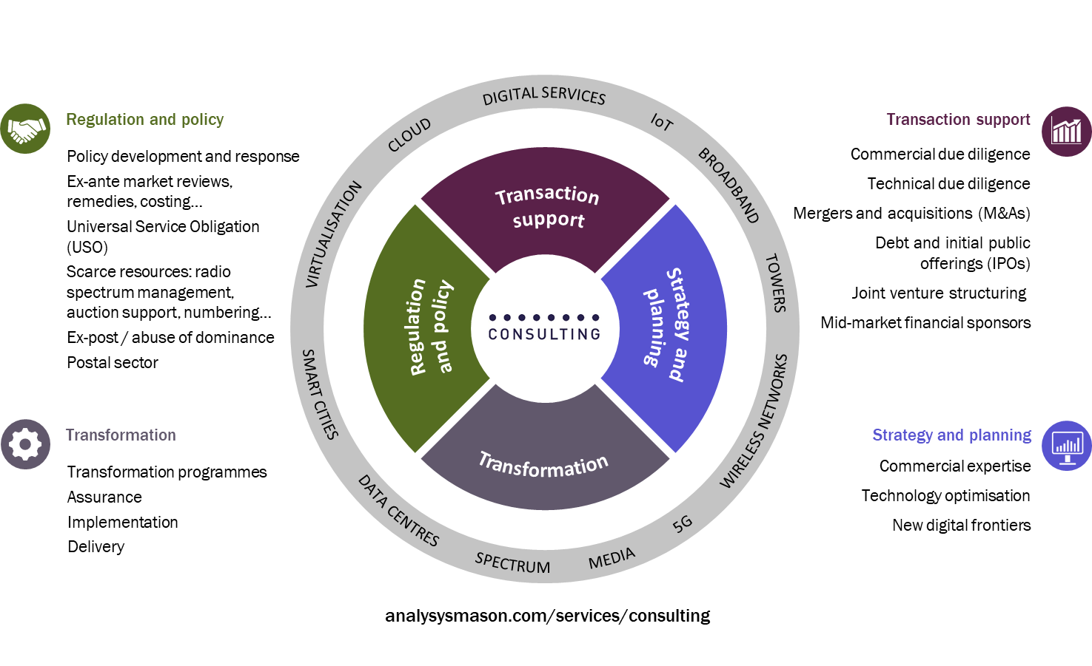
Our consulting expertise covers the breadth of TMT issues and challenges

Slide 64
AUGUST 2020

